Slide 1
Quest for Actionable Intelligence
Install A Movìri ETL Module
Movìri Integrator for TrueSight Capacity Optimization - HP NNMi
Conversations about TSCO
Significant use of the notes section.
Download the PPT for the notes.
Andrea Gallo – andrea.gallo@moviri.com
Notes:
Movìri Integrator for TrueSight Capacity Optimization - HP NNMi

Slide 2
Agenda
Use Case - Movìri NNMi Module
Starting Point
Where are the downloads
Install packages on TSCO
Datasource check and configuration
Implied connection and path
Connector Configuration (TSCO ETL Config)
Troubleshoot
Find data on Workspace Tab
Call To Action
Questions
Notes:
Agenda:
Discuss the use case and starting point.
We will get the downloads needed. Install the packages on TSCO. Then configure the data source (on the data source side)
Implied but not mentioned in the documentation, is a path and permissions between TSCO and the Data source
Then we configure the connector, make a connection and troubleshoot as necessary to find the data on the Workspace tab
We will then close with a call to action and have time for questions

Slide 3

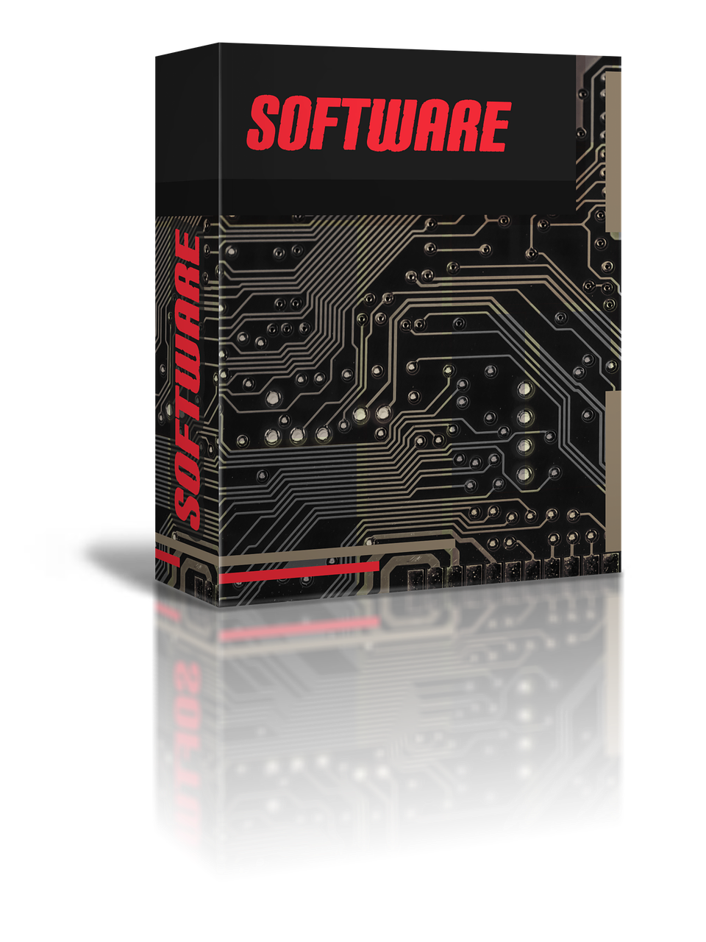
Use Case
We are sent to help the TSCO administrator install a new ETL Module
We have limited exposure to the TSCO application
Documentation assumes that we are aware of things that we are just not
To help solve this we will try to back fill this information and use a Movìri NNMi Module as our example.
Notes:
In our use case, we have been sent to help the TSCO administrator to install a new ETL Module. However, while we are competent in all things server, we have limited exposure to the TSCO application. As a result we find the documentation assumes that we are aware of things that we are just not.
To help solve this, this presentation will try to back fill this information, and use a Movìri NNMi Module as our example.
Movìri Integrator for TrueSight Capacity Optimization - HP NNMi
https://docs.bmc.com/docs/capacityoptimization/btco115/moviri-integrator-for-truesight-capacity-optimization-hp-nnmi-830156763.html#MoviriIntegratorforTrueSightCapacityOptimization-HPNNMi-Connectorconfiguration

Slide 4

Given the Starting Point
Overview
Requirements
Installation
Data source Check and Configuration
Notes:
For example, we were given the URL that covers the process…
https://docs.bmc.com/docs/capacityoptimization/btco115/moviri-integrator-for-truesight-capacity-optimization-hp-nnmi-830156763.html
It starts out with a helpful overview and requirements section, but we are quickly lost as the installation section and datasource check and configuration section has made assumptions we are not aware of.
We verify the requirements section with our internal resources for NNMi (data source)
Then find the install packages for the Module
https://docs.bmc.com/docs/capacityoptimization/btco115/moviri-integrator-for-truesight-capacity-optimization-hp-nnmi-830156763.html#MoviriIntegratorforTrueSightCapacityOptimization-HPNNMi-Connectorconfiguration

Slide 5

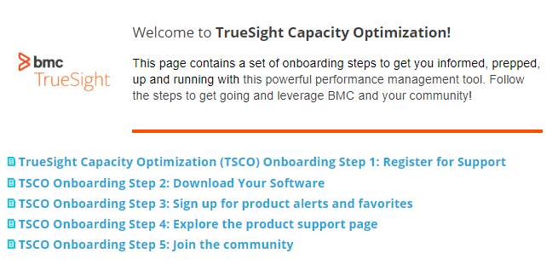
Assumes you have the downloads
Onboarding Step One
Register with BMC Support Central
Setup account with BMC Support (will need Support ID and PIN)
Onboarding Step Two
Download the software from Electronic Product Distribution (EPD) website
https://communities.bmc.com/community/bmcdn/capacity_management/pages/onboarding
Notes:
This document assumes you know of, and have done steps one and two of the Onboarding
https://communities.bmc.com/community/bmcdn/capacity_management/pages/onboarding
https://communities.bmc.com/docs/DOC-128143
https://communities.bmc.com/docs/DOC-128144
These two steps helps you setup and register for BMC Support, which also give a link to the BMC software to download.
It is helpful to know that the TSCO server is generally not in a place that can access the internet, so the download is done on a device that can both download the file (access the internet) and login to the TSCO interface with privileged credentials. Assumed to be your desktop.
Download the files from support to your local desktop.

Slide 6
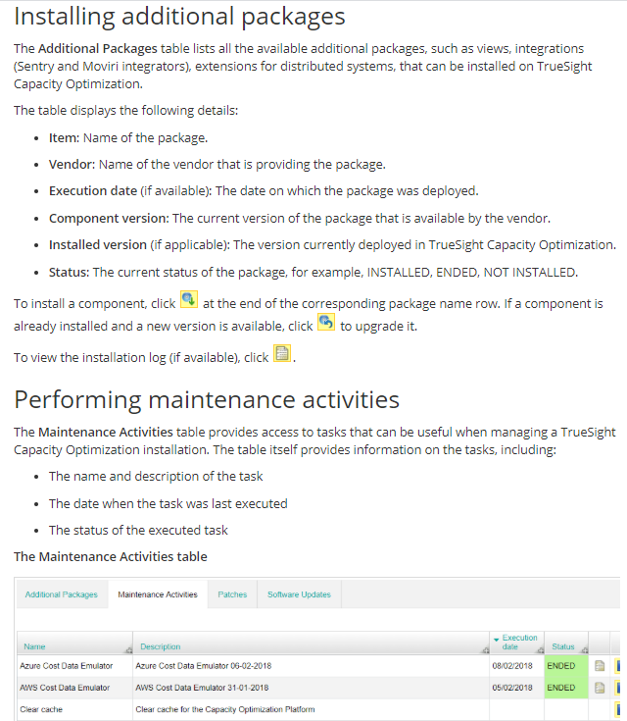

Install additional packages on TSCO
Notes:
Installing the additional package –
From the same desktop, connect to TSCO with admin credentials
https://docs.bmc.com/docs/capacityoptimization/btco115/performing-system-maintenance-tasks-830157622.html#Performingsystemmaintenancetasks-additional_packagesInstallingadditionalpackages
Our use case suggest that you do not have “Movìri - HP NNMi” already installed. (or whatever additional package is your mission)
At the bottom of the Administration | System | Maintenance | Additional Packages tab (inside TSCO) you find the ‘Choose File’ option.
Find the package you downloaded to your local desktop and Upload it to the TSCO system.
Once the item is ‘in the list’ of ‘Additional Packages’ Then install the item per the ‘Installing additional packages’ section

Slide 7

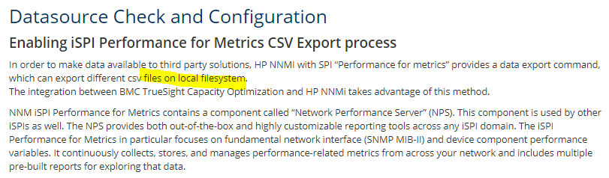
Datasource Check and Configuration
The ‘local filesystem’ of the first paragraph is that of the NNMI device (not TSCO device)
This whole section is done on the NMMi devices
Notes:
Datasource Check and Configuration
The ‘local filesystem’ of the first paragraph is that of the NNMI device (not TSCO device)
This whole section is done on the NMMi devices
The configureCsvExport.ovpl file is found on the NNMi device The path to the file is in the instructions
https://docs.bmc.com/docs/capacityoptimization/btco115/moviri-integrator-for-truesight-capacity-optimization-hp-nnmi-830156763.html#MoviriIntegratorforTrueSightCapacityOptimization-HPNNMi-Connectorconfiguration
For other data sources there may not be an install necessary.
===

Slide 8

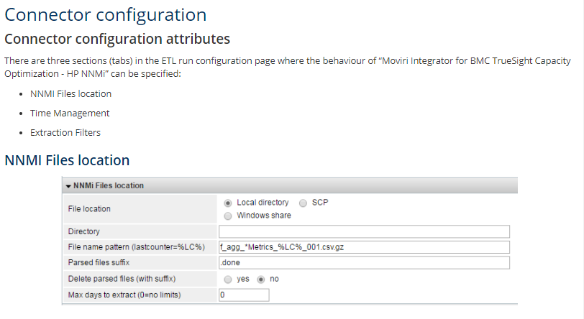
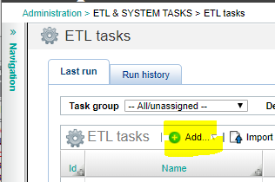
Connector Configuration (on TSCO interface)
This section is done on the TSCO console and assumes that you have started to create a new ETL for the NNMI device
Notes:
Connector Configuration
This section is done on the TSCO console, and assumes that you have started to create a new ETL for the NNMI device
Administration | ETL & System Tasks | ETL Task
Then click Add | Add ETL | be sure the Movìri – HP NNMi is in the ETL Module list and select it. IF it is not in the list then it has not been added properly in the above steps.
https://docs.bmc.com/docs/capacityoptimization/btco115/etl-common-configuration-properties-830156528.html
Can help with the settings on the other ETL configuration sections
While
https://docs.bmc.com/docs/capacityoptimization/btco115/moviri-integrator-for-truesight-capacity-optimization-hp-nnmi-830156763.html#MoviriIntegratorforTrueSightCapacityOptimization-HPNNMi-Connectorconfiguration
Will help with the NNMi specific “Connector configuration”
There are a few items that have an exactly correct answer. However, many items have ‘mostly correct answer for what we want to do’ type answer. The various SMEs will need to contribute to the configuration based on the environment and expected result.

Slide 9
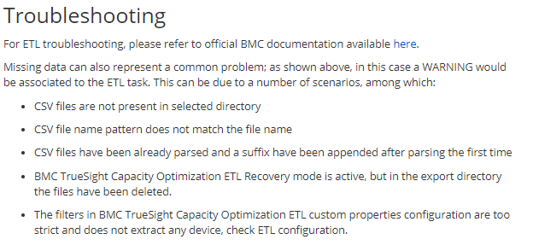
Troubleshooting
The TSCO administrator should be able to direct the troubleshooting effort.
Gather what you report on, report on what you gather.
Notes:
Troubleshooting
The TSCO administrator should be able to direct the troubleshooting effort.
While these links may help with troubleshooting, know that smaller more frequent ETLs is generally preferred (once a day is generally better than once a week). Impact of the data source is generally the primary scheduling concern. IF the data source has an intensive routine right after midnight, maybe a morning connection may be better (lower impact to the system and the system users). IF the data source is used intensely first thing in the morning, maybe an afternoon connection may be better (lower impact to the system and the system users). Getting recent data is generally better than trying to back fill first. Get data started, then back fill. Configuration can be changed, as necessary. Generally start with a lighter load than add, rather than start with everything and back off to mitigate impact. Gather what you report on, and report on what you gather.
https://docs.bmc.com/docs/display/public/btco105/Working+with+ETLs
https://docs.bmc.com/docs/display/public/btco105/Managing+ETL+and+System+tasks#ManagingETLandSystemtasks-Taskexecutionlogs
https://docs.bmc.com/docs/display/btco107/Moviri+ETL+modules

Slide 10
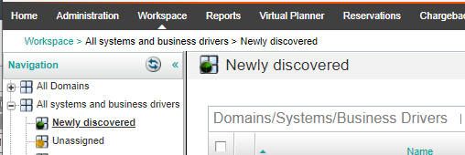
Workspace tab
Data goes to the data warehouse first, then makes its way to the Workspace Tab
Find data on the Workspace Tab
Report on the new data
Notes:
When the ETL runs, the data goes to the data mart first. It is then processed to get into the TSCO database proper.
This can take some time.
Find data on the workspace tab
While configuring the ETL, you stated where the object relationship should go by default. Into a new domain, existing domain or the already created ‘Newly Discovered’ location.
Monitor this location for the new entities and new data.
As the new data is ingested, it can be reported on.

Slide 11
Check List (from data source)
Check Data source (has data we wish)
Data source exposes data
TSCO can connect to data source
Exposed data location / method
Path (network and ports)
Username / Passphrase
Query or Integrator
TSCO has Integrator available (or ETL)
Integrator (or ETL) is installed and configured
Integrator (or ETL) is connecting and delivering data to TSCO
TSCO reports with available data

Slide 12
Call to action
Do this example
While this uses a specific module as the example, most modules work in substantially the same way.
There are a number of links in the notes section of this presentation to documentation that are specific to tasks for this example, but also apply to other modules. Sometimes a little imagination is needed to stich together several tasks to deliver an expected outcome.
We hope that this helped stich these tasks together.
Notes:
Do this example
While it uses a specific module as the example, most modules work in substantially the same way.
There are a number of links that are specific to this example but also apply to other modules. The documentation is useful for describing what things are, on the different screens, but sometimes a little imagination is needed to stich together several tasks to deliver an expected outcome.
We hope that this helped stich these tasks together.

Slide 13
Questions
This was not helpful. What can I do now? Open a support ticket with BMC or your support partner.
https://www.bmc.com/support/support-central.html
And send a note to support@moviri.com with comments
IF this WAS helpful, send a note to Andrea.Gallo@moviri.com with comments. We like to hear from you.
What if I have other, unrelated questions and comments. BMC and Movìri would be happy to help in any way we can using the links above or contact your account team.

Slide 14
Links
Topic | Link
Movìri Integrator for TrueSight Capacity Optimization - HP NNMi | https://docs.bmc.com/docs/capacityoptimization/btco115/moviri-integrator-for-truesight-capacity-optimization-hp-nnmi-830156763.html#MoviriIntegratorforTrueSightCapacityOptimization-HPNNMi-Connectorconfiguration
Communities Onboarding | https://communities.bmc.com/community/bmcdn/capacity_management/pages/onboarding
Onboard Step 1 | https://communities.bmc.com/docs/DOC-128143
Onboard Step 2 | https://communities.bmc.com/docs/DOC-128144
System Maintenance Tasks | https://docs.bmc.com/docs/display/btco107/Performing+system+maintenance+tasks#Performingsystemmaintenancetasks-Installingadditionalpackages
Working With ETLs | https://docs.bmc.com/docs/display/public/btco105/Working+with+ETLs
ETL documentation | https://docs.bmc.com/docs/display/public/btco105/Managing+ETL+and+System+tasks#ManagingETLandSystemtasks-Taskexecutionlogs
ETL documentation | https://docs.bmc.com/docs/display/btco107/Moviri+ETL+modules
BMC Support | https://www.bmc.com/support/support-central.html
Movìri | http://www.moviri.com/

