Slide 1
Quest for Actionable Intelligence
TrueSight Capacity Optimization Value Proposition for
Information Technology
Conversations about TSCO
Andrea Gallo – andrea.gallo@moviri.com
Notes:
This is a webinar conversation about the TrueSight Capacity Optimization Value Proposition for Information Technology
Our goal is to help clarify the capacity optimization value proposition, and to provide specific tools and techniques to assist in the Quest for Actionable Intelligence.
With a clear mission (Jobs, pains and gains) and actionable intelligence from TSCO, the capacity manager function delivers significant value to their customers within the Organization and to the Organization itself.
In this session - The value proposition is the focus:
Which customer needs are you satisfying? What pain points are you relieving? What jobs do you help the customer get done?
What products and services do you have that deliver value to your customer?
What channels are used to deliver value? How much friction comes with those channels?
What is the relationship your customer has with you? Do they see you as a necessary evil? Do they see you as a partner and enabler?
Come join Moviri for a fast paced new look at the TSCO Value Proposition for Information Technology.

Slide 2
Agenda
Moviri
Value Proposition
Tools to develop a value proposition
Making a value proposition
Questions??
Notes:
This is a webinar conversation about the TrueSight Capacity Optimization Value Proposition for Information Technology
Our goal is to help clarify the capacity optimization value proposition, and to provide specific tools and techniques to assist in the Quest for Actionable Intelligence.
Our agenda is a quick introduction to Moviri
Then a conversation about what a value proposition is, and the tools to develop a value proposition.
Then we will make a value proposition that we will expand on in future webinars.

Slide 3




Why Listen To Us
Movìri is a global IT consultancy with multiple offices in the US and around the globe
More than 200 engineers worldwide
More Doctors than most hospitals ☺
Developers of Caplan, become BMC TrueSight Capacity Optimization
Movìri has several lines of business:
Testing & Optimization
Monitoring
Operations and Cloud
Security, Analytics
Capacity Management
Big picture, many disciplines, much experience
ContentWise.com; Cleafy.com; AKAMAS.IO
We can help you do this quickly and cleanly
Notes:
So why listen to Moviri?
Movìri is a global IT consultancy with multiple offices in the US and around the globe
More than 200 engineers world wide we have more Doctors than most hospitals!
Started as Neptuny, developers of Caplan, a magic quadrant capacity optimization product. Purchased by BMC in 2010 to become BMC Capacity Optimization, which is now BMC TrueSight Capacity Optimization. Neptuny became Movìri.
Movìri has several lines of business, including Testing & Optimization, Monitoring. Operations and Cloud, Security, Analytics, and Capacity Management – which is to say we think holistically. Big picture, many driplines, much experience, and continue to offer innovative products, including ContentWise; Cleafy; AKAMAS
Movìri has been doing this a long time, and is a thought leader and innovator.
And most importantly, you should listen to Movìri because: We can help you do this – quickly, and cleanly.
So, Let us jump right in…
===
https://www.crunchbase.com/organization/neptuny
http://www.moviri.com/2010/10/goodbye-neptuny-welcome-moviri/
https://www.moviri.com/news-events/akamas-ai-powered-performance-optimization-solution/
https://www.moviri.com/
https://www.akamas.io/
https://www.contentwise.tv/
https://www.cleafy.com/
https://www.linkedin.com/company/moviri/about/

Slide 4
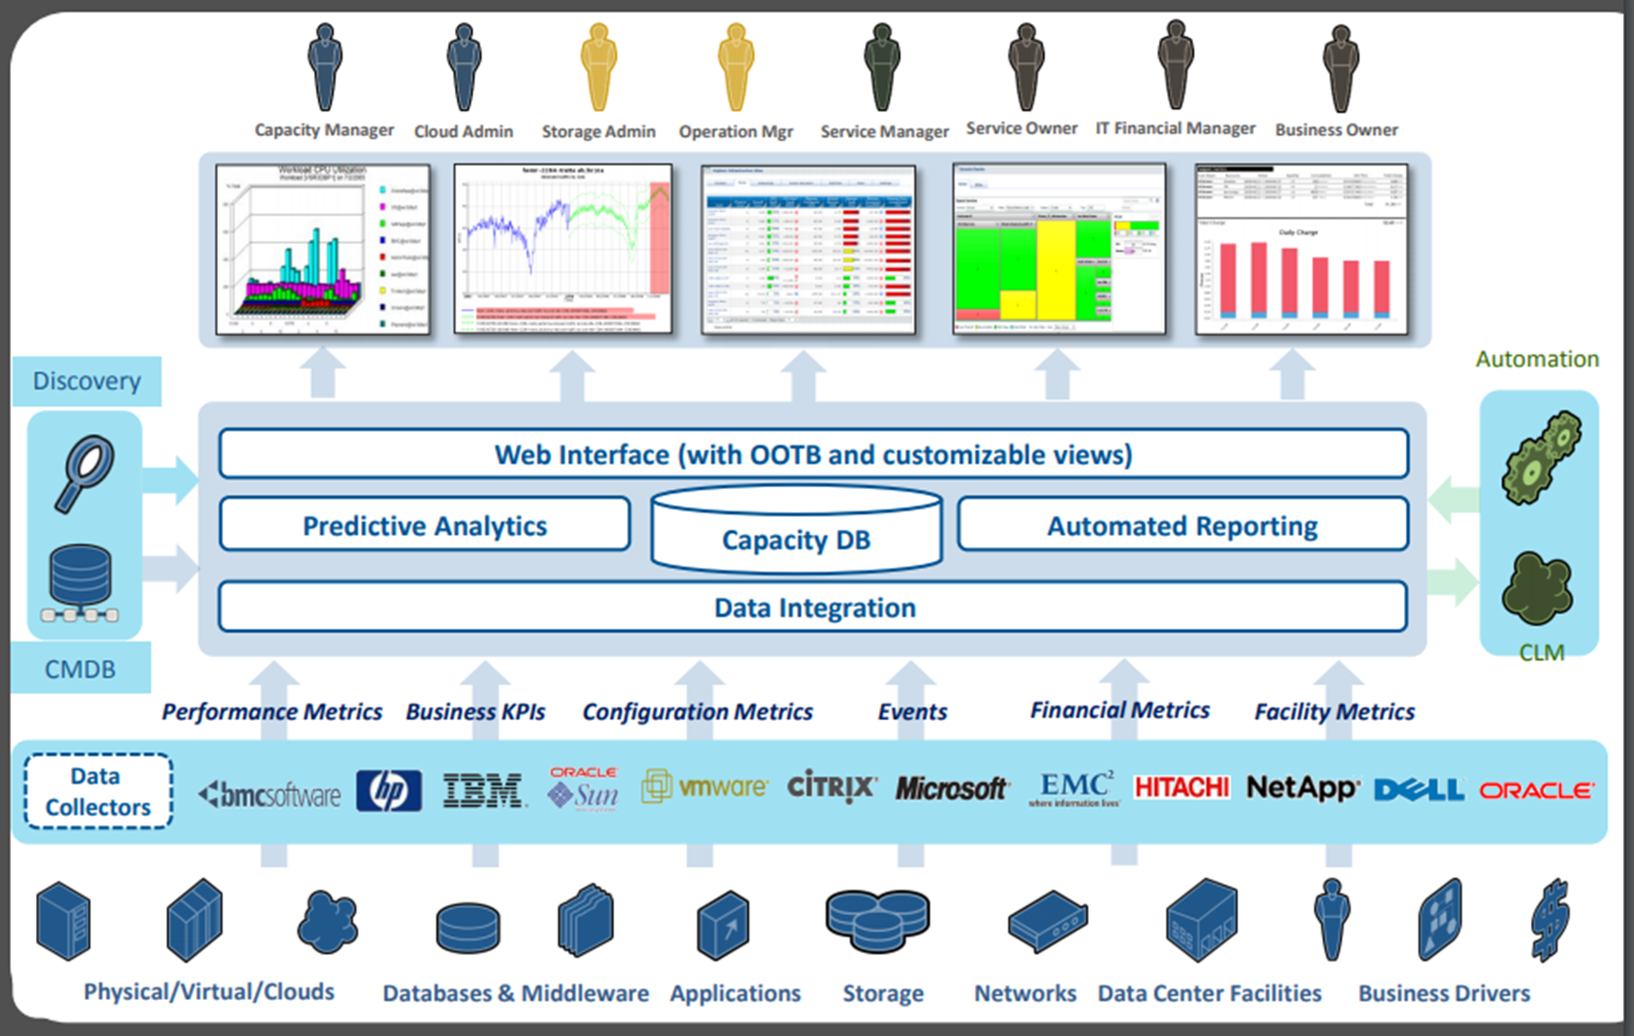
Quest for Actionable Intelligence
Notes:
Quest for Actionable Intelligence
This is a typical view of TSCO (TrueSight Capacity Optimization). Customers at the top consume data in the form of charts, reports, tables, graphs etc.. In their Quest for Actionable Intelligence
This data comes from a number of data sources via ETL processes (Extract Transform Load). (bottom of the screen)
Then this data is given structure, associations, context and other enrichments from Configuration management databases, association tables, and fact sheets.
The Value Proposition, or the value that the customer gets is not always clear, complete or assessed correctly. This conversation focuses on being sure that the customer’s needs are being met, to the extent practicable.
Our goal is to help clarify the capacity optimization value propositions, and to provide specific tools and techniques to assist in the Quest for Actionable Intelligence.
With a clear customer mission (Jobs, pains and gains) and actionable intelligence from TSCO, the capacity manager function (‘owner’ of the TSCO solution) delivers significant value to their customers within the Organization and to the Organization itself.

Slide 5

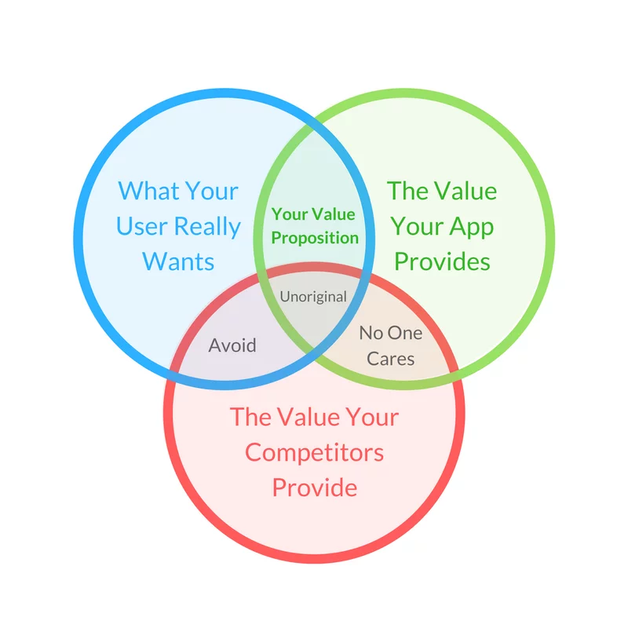
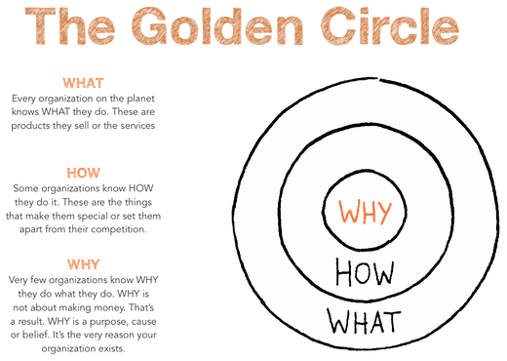
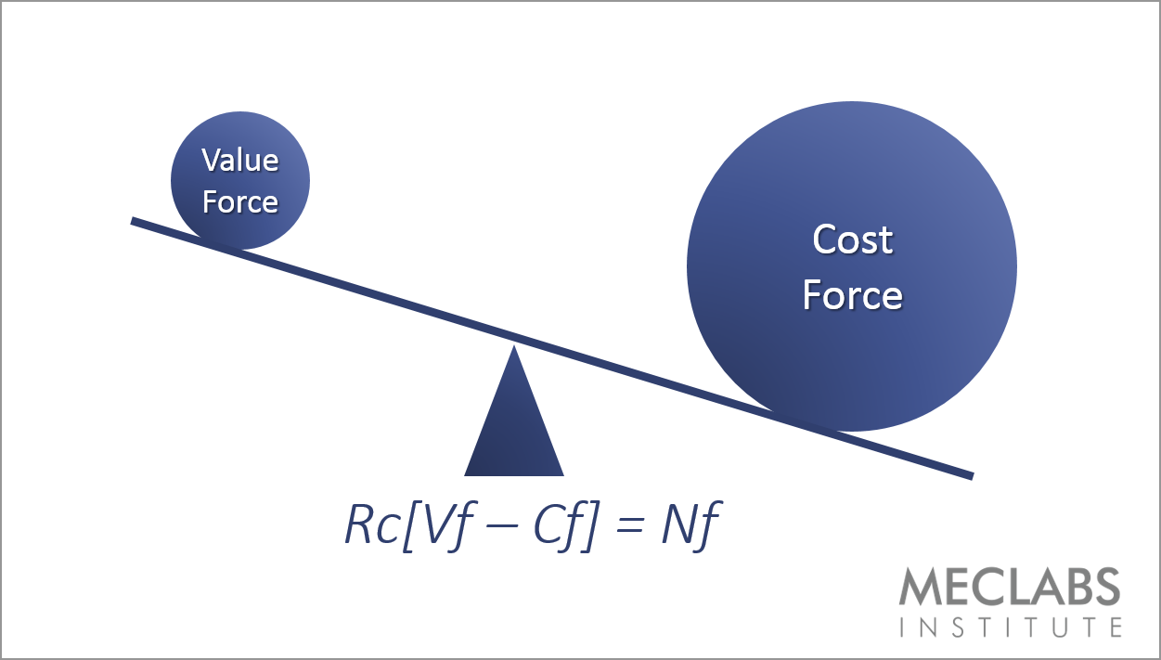

Define Value Proposition
Notes:
Have you correctly defined your value Proposition?
There is an assumption that we have appropriately, adequately, identified and articulated to our customer, our value proposition, and that our customer agrees with us. It is my experience that this is NOT TRUE. We know what we THINK the customer wants, but we have rarely verified this. Yet we offer it up as if it were the very best of the very best, when in fact it may be only marginally adequate for our customers needs.
====
Links of other conversation about value proposition
https://www.kissclipart.com/plan-do-check-act-png-clipart-logo-pdca-act-6n7r4b/download-clipart.html
https://allbusinesstoolkit.com/strategic-positioning
https://www.smartinsights.com/digital-marketing-strategy/online-value-proposition/start-with-why-creating-a-value-proposition-with-the-golden-circle-model/
https://blog.digistorm.com.au/what-is-a-usp-and-why-is-it-important-to-your-school
https://marketingexperiments.com/value-proposition/not-price

Slide 6
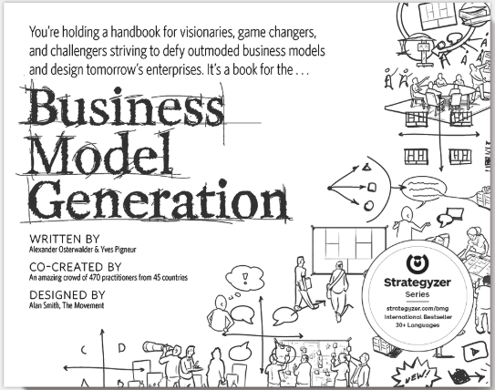
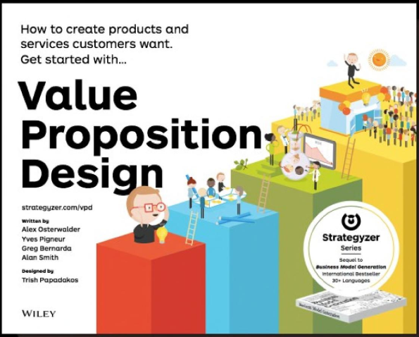
A useful place to start….
Even a poor plan, executed with conviction, will work.
Notes:
As most do not realize they are failing their customers, it may be helpful to verify that you and your customers are in the same relationship. Business Model Generation and Value Proposition Design is offered as one of many possible ways to make a value proposition. We are not suggesting that this is the correct way, or even one of the correct ways, but rather just one way to think about your value proposition. We like it enough, as it is graphical, straight forward, and easy to get a result.
We offer it as ONE way – and suggest that ‘even a poor plan, when executed with conviction, will work’. Meaning that this or any other similar exercise will allow you to identify your customer and value proposition well enough to evaluate if it correct and complete enough. Then through a progression of Plan Do Check Act process improvements cycles, you will arrive at a workable customer identification and value proposition, that works for the customer. Note you may have several customers, each with their own value proposition.
Here is a useful place to start. The business Model Generation and Value Proposition design.
As a bit of background, these are based on the PhD Thesis by Alexander Osterwalder (if you are into reading Thesis papers this is a ‘good one’)
The next few slides are an outline of the models discussed in these books.
=====
https://www.strategyzer.com/
Over 5 million people use our Business Model Canvas. Join them by using our platform and services to clearly understand customers, create better products, and grow businesses.
====
http://www.hec.unil.ch/aosterwa/PhD/Osterwalder_PhD_BM_Ontology.pdf
UNIVERSITE DE LAUSANNE
ECOLE DES HAUTES ETUDES COMMERCIALES
___________________________________________
THE BUSINESS MODEL ONTOLOGY
A PROPOSITION IN A DESIGN SCIENCE APPROACH
THESE
Présentée à l’Ecole des Hautes Etudes Commerciales
de l’Université de Lausanne
par
Alexander OSTERWALDER
Licencié en Sciences Politiques de l'Université de Lausanne
Diplômé postgrade en Informatique et Organisation (DPIO)
de l'Ecole des HEC de l'Université de Lausanne
Pour l’obtention du grade de
Docteur en Informatique de Gestion
2004

Slide 7
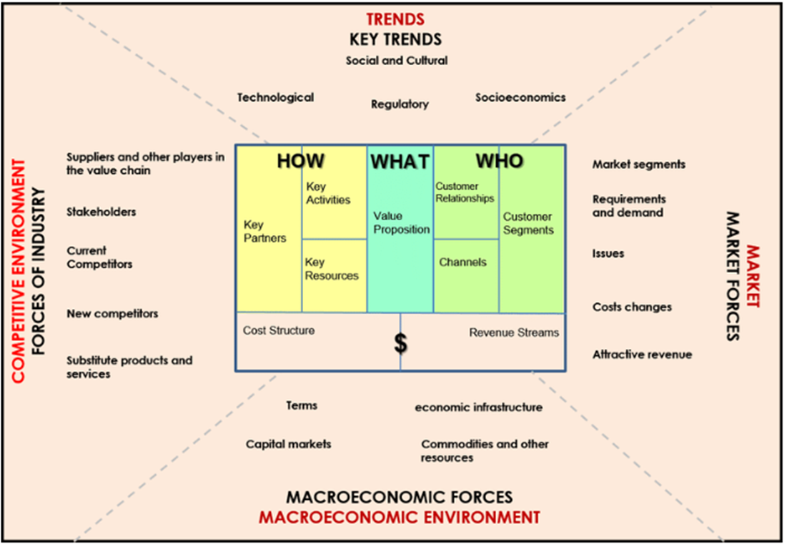


The Environment Map
Notes:
At the highest level you have
The Environment Map
Helps you understand the overall context in which you create a Business Model
Note that this explores external forces that define the business model in the middle. The trends, markets, economic, and competitive environment all constrain / influence the business plan.
The business model is essentially the HOW, WHAT, WHO and for what PRICE, and is the box in the middle.

Slide 8
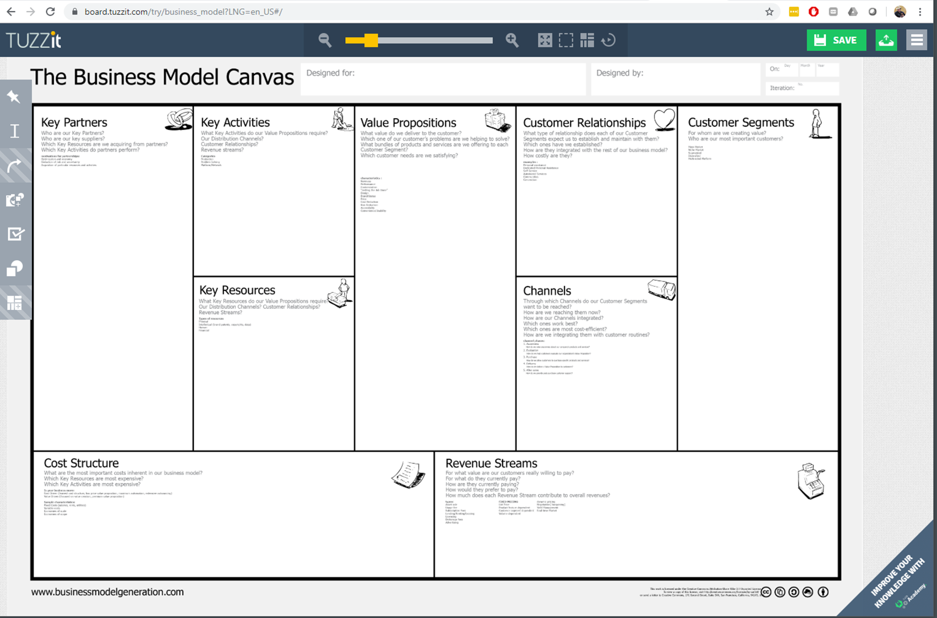
Business Model Canvas
WHAT
HOW
WHO
$ $ $ $
Notes:
Next level of detail is
The Business Model Canvas
Helps you create a business model for your business.
While we won't get into detail:
The How includes Key Partners, Key activities and Key Resources
The What is the value propositions
The Who includes your customers, channels to get to the customers and the relationships with the customers
Finely the Price is at the bottom of What are the costs to make the value propositions vs the Revenue streams provided by the Value propositions.
The odd square and circle are the analysis of the value proposition and the specific customer for that proposition. - while they are shown as one thing, there is a pair for each customer value proposition in the business model. For the Capacity Optimization conversation there are several dozen value propositions, one for each customer segment including:
Capacity Manager, cloud manager, operations manager, service manager, application manager, business manager, finance manager…. Etc. They are the customers at the top of the ‘typical view of the TSCO solution’
===
https://en.wikipedia.org/wiki/BMC_Software
The company was founded in Houston, Texas, by former Shell Oil employees Scott Boulette, John J. Moores, and Dan Cloer, whose surname initials were adopted as the company name BMC Software.
https://en.wikipedia.org/wiki/Business_Model_Canvas
Business Model Canvas is a strategic management and lean startup template for developing new or documenting existing business models.[1][2] It is a visual chart with elements describing a firm's or product's value proposition, infrastructure, customers, and finances.[3] It assists firms in aligning their activities by illustrating potential trade-offs.
The Business Model Canvas was initially proposed by Alexander Osterwalder[4] based on his earlier work on business model ontology.[5] Since the release of Osterwalder's work around 2008,[6] new canvases for specific niches have appeared.

Slide 9
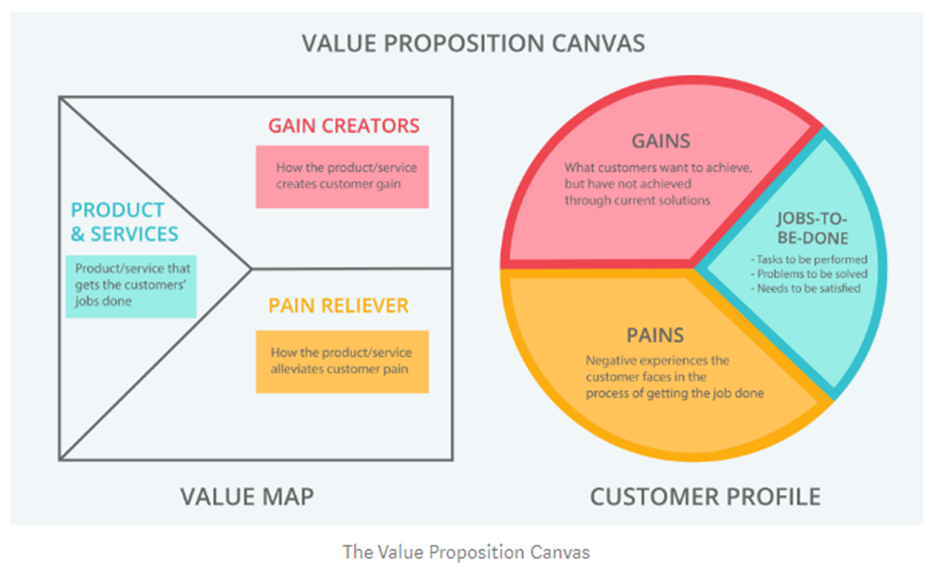
Your products and services relieve the pains, and provide the gains, so that the Customer can get their job done.
Notes:
Value proposition Canvas
The Customer Profile (right side) lists:
Jobs to be done: Tasks to be performed, problems to be solved, needs to be satisfied (These can be organizational, emotional, political, physical etc)
Pains: negative impacts of not getting the job done and undesirable experiences to be avoided or reduced. (These can be organizational, emotional, political, physical etc)
Gains: Positive impacts of getting the job done and desirable experiences to be gained or maximized. (These can be organizational, emotional, political, physical etc)
The Value Map (left side) answers these questions:
What value do we deliver to the customer?
Which of our customer’s pains are we helping to relieve?
Which customer gains are we creating?
What bundles of products and services are we offering to each Customer Segment to get their job done?
Said differently, your products and services relieve the pains, and provide the gains, so that the Customer can get their job done.

Slide 10
Actionable Intelligence
Notes:
For the TSCO Application Model - Our customers are across the top and the value proposition are variations of Actionable intelligence.
While they all need ‘almost the same data’ they need it in different groupings, associations, and levels of detail.
The TSCO value propositions are predicated on the value of bringing data together into a single place where existing data can be leveraged, compared, contrasted, associated, grouped, and otherwise manipulated in one place to answer a host of business questions from a number of different business customers, and presented in a way to ‘tell the story’ appropriate to the customer.
So the capacity manager can focus on his question of the day, while the cloud admin can focus on aspects of cloud. Infrastructure owners and managers along with application and service owners and managers, and even business owners and financial managers can see all of the subject data through lenses important to them.
So when we say Actionable Intelligence, we mean Actionable Intelligence as see by the customer.
As the capacity team, we are out own customer. So lets look at that value map in more detail.
===
6 point free hand line
Orange

Slide 11


Value Proposition for Capacity Manager
TSCO Tool
Customer
Products and Services
Workspace tab
Scheduled reports
Ad hoc reports
Filter based reports
Exception reports
Tag based reports
Presentation Service
Technology based reports
Custom reporting
Interactive drill down reporting
Summary reporting
Gain Creators
Self service reporting
Robust reporting and visualization
Multiple association methods
Consolidation of data sources
Business counts and analysis
More time spent on analysis
Gains
Guess less
Be right more often
Confident in analysis
Quickly deliver answers
Talk to business in business language and metrics
Customer Jobs
Current Inventory
Forecast need
Control costs
Accommodate business requests
Gracefully add new technology
Gracefully remove old technology
Provide adequate performance at an acceptable price
Pain Relievers
Data in one place
Quality data presentation methods
Web based for easy access
Gather ‘non capacity’ data
Automatic processes for data update
Pains
Difficult to gather data
Coordinate with business
Communicate with business and tech owners
Present data in clear concise ways
Make actionable intelligence easily available to our Capacity Manager Customer such that they can effectively address their IT capacity, trending, forecasting and anomaly detection concerns in IT and Business terms
Notes:
Here is a Value Proposition for the Capacity Manager as the customer and TSCO tool as the value provider.
Summarized nicely with
“Make actionable intelligence easily available to our customers such that they can effectively address their IT capacity, trending, forecasting and anomaly detection concerns in IT and Business terms”
While many of your TSCO customers will have similar value propositions some of the details will change. Think what else would be included for the app owner, finance manager, security group, audit department, and technology owner.
Compare that to what TSCO offers that their other tools do not.
Hint: the technology owners have ‘their own tools’ to address most of their jobs and pains. TSCO will NOT be their favorite tool unless you can deliver pain relievers and gains that are NOT easily available with their other tools.
Sample Value Propositions
Customer Profile – Capacity Manager
https://www.helpsystems.com/solutions/it-operations-management-automation/service-delivery-itil-version-2/capacity-management
https://en.m.wikipedia.org/wiki/Capacity_management
Jobs to be done: Predict new spend, retire old technology gracefully, add new technology cost effectively
Pains: Business Plans not available, critical applications not well defined, performance metrics not well defined, thresholds not set or relevant, costs not easily allocable, Total Cost of Ownership difficult to break down by technology, service, application, or other groupings
Gains: Deliver agreed performance and acceptable price with expected reliability
****
We could do similar studies for other customers…
Customer Profile – Application Manager
Jobs to be done:
Pains:
Gains:
====
Customer Profile – ?????
Jobs to be done:
Pains:
Gains:
Value Proposition is very close for each but has some unique information / reporting for each
******
Product & Services: web interface with customizable views / reports; Web interface with Just in time reporting, scheduled reporting, and investigation tools. Consolidation of data from multiple sources in a single place with multiple options to organize, correlate, and display based on the preference of the user.
Pain Reliever: can collect business plans and model the impacts on the subject infrastructure, Critical application definitions done in application management and configuration management areas, can be made available to the web based reporting environment; Performance Metrics can be reported on in a central place for individual groups and /or pieces of equipment; Costs from charge back / show back / shame back systems can be made available to the web based reporting environment;
Gain Creators: Near frictionless, self service, and to easy to access and use reporting. Caned and custom reporting created and delivered with minimal manual effort. Ability to ingest multiple data types and sources. Ability to correlate and associate by various data points. As data collection is already completed more time is spent on analysis.

Slide 12
Quest for Actionable Intelligence (IT Capacity Optimization)
Notes:
That should have shown how we might have arrived at The Business Model and Value Proposition the Capacity Optimization Efforts
Customer Profile = Describes a specific customer segment in your business. This details the customers jobs, pains and gains.
Don’t get freaked out when you find that the Capacity Manager version of you, is the customer of the TSCO Manager version of you.
Value Proposition = Make actionable intelligence easily available to our customers such that they can effectively address their IT capacity, trending, forecasting and anomaly detection concerns in IT and business terms.
That is to say, help our TSCO customers in their Quest for Actionable Intelligence.
In follow on sessions, we will expand on a value proposition details and the specific products and services TSCO offers to deliver actionable intelligence to that specific customer.

Slide 13
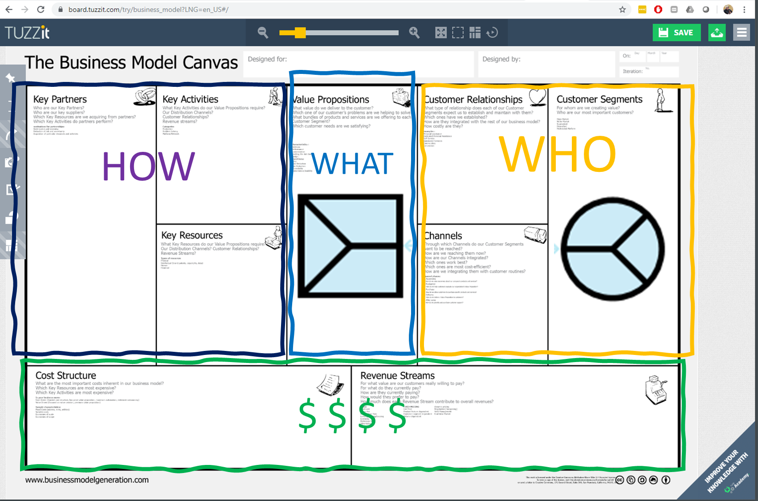


Thank you for your Attention. Q & A Time
Make actionable intelligence easily available to our Capacity Manager Customer such that they can effectively address their IT capacity, trending, forecasting and anomaly detection concerns in IT and Business terms
Notes:
Thank you for your time and attention.
Moviri would like to help you on your Quest for Actionable Intelligence.
Email Andrea.Gallow@Moviri.com To start a conversation.
Tell him @MrBenHoney sent you ☺

Slide 14
Notes:
We want to be YOUR partner in your quest for Actionable Intelligence

