Slide 1



MULTIVARIATE IT CAPACITY MODELING
A REAL-WORLD EXAMPLE OF INFORMATION TECHNOLOGY DELIVERING TIMELY, ACTIONABLE, INTELLIGENCE.
Presented to you by:
BEN DAVIES
ANDREA VASCO
Notes:
Good afternoon.
Welcome to CMG Impact 2017. This is a conversation about “Multivariate IT Capacity Modeling.. A real-world example of information technology delivering timely, actionable, intelligence.”
=== One hour presentation
https://edas.info/p23354#S1569544579
1:00 Multivariate IT Capacity Modeling Andrea Vasco and Benjamin Davies
CAP
Wouldn't it be great to be able to make a capacity model of an application that has multiple components and functions that are distributed over several devices, where those devices are shared with unrelated applications? This white paper examines this very real-world situation. The results achieved with actual customer data prove that not only is multivariate capacity modeling achievable, but it is relatively easily performed with COST software, tools and techniques. In this real-life example, an IT Organization wants to model a two-fold increase in logins in the next quarter, resulting in the growth of two specific workloads, increasing usage by 350% and 450%, while the rest of the workloads remained essentially the same. The intuitive expectation was that the existing equipment would not accommodate the request, so the IT Organization needs not only to validate the expectation but also to produce options, driven by actual data and detailed analysis. The outcome of using existing tools, available data, and skillful application of modeling and analysis techniques enables the IT Organization to create 4 different scenarios based on budget, risk, IT resource and business impact.
Presenter bio: IT professional with 10+ years of experience in the industry, innovator, leader, influencer, analytics and data engineering enthusiast. My experience is characterized by a strong link between the academic and the IT industry: I started working as Politecnico di Milano intern for the Italian Space Agency and then moved into the Consulting business working with the most IT-intensive firms in the World. As Architect and Team Leader I delivered dozens of successful initiatives for several Fortune 100 companies worldwide, and mentored several young stars. As Head of Operations, I lead an international team of engineers, support the hiring process and look for innovation opportunities being the main point of contact for the most important universities in the Country. I am responsible for the fulfillment of the Company revenue and growth expected results, reporting directly to the Executive Board.

Slide 2
MISSION
Wouldn’t it be great to be able to make a capacity model of an application that has multiple components and functions that are distributed over several devices, where those devices are shared with unrelated applications?
Notes:
Wouldn’t it be great to be able to make a capacity model of an application that has multiple components and functions that are distributed over several devices, where those devices are shared with unrelated applications?
===
This conversation examines this very situation. The results achieved with existing customer data prove that not only is multivariate capacity modeling achievable, but it is relatively easily performed with COTS (Commercial Off The Shelf) software, and accessible tools and techniques.

Slide 3
AGENDA
Field of Play
Movìri Solution
Now What Options Are Apparent
Results
Questions & Answers
Notes:
This conversation examines this very situation. The results achieved with existing customer data prove that not only is multivariate capacity modeling achievable, but it is relatively easily performed with COTS (Commercial Off The Shelf) software, and accessible tools and techniques.
Today we will cover our use case details, the Movìri solution, what options became aparent, discuss the result, then open up for questions, but feel free to ask questions as we go.
I might also point out that there is a white paper on this topic if you prefer that format. www.Movìri.com

Slide 4
FIELD OF PLAY

Slide 5
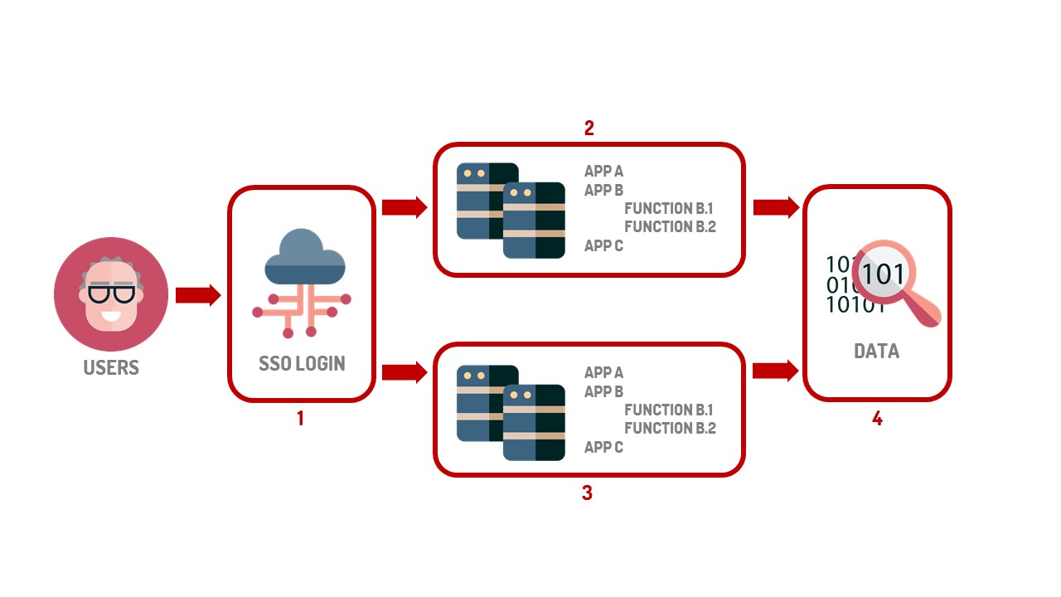
INTRODUCING THE USE CASE
The use case is that application B volume is changing,
but Application A and Application C are not.
Notes:
This is an image of the infrastructure that we find at the client.
Our goal is to “work” on application B, which is in a shared infrastructure with application A and C.
The use case is that application B volume is changing but Application A and Application C are not.
The Customer had determined that the design has out grown it mission and they have a long range plan to redesign this to break apart the applications a bit more, and add hardware for future growth.
However, there was a new, immediate request for a workload increase.
===
Movìri was contracted to help our customer create a capacity model on an application that has multiple components and functions distributed over several devices, and those devices are shared with unrelated applications.
===

Slide 6
SOME MORE DETAILS
SSO Login to application “B” expected to increase by 200% (Box 1)
Application “B” function b.1 is expected to increase by 350% (Box 2 and 3)
Application “B” function b.2 is expected to increase by 450% (Box 2 and 3)
All the other hosted applications and functions are not expected to change
Notes:
This is an image of the infrastructure that we find at the client.
Our goal is to “work” on application B, which is in a shared infrastructure with application A and C.
The use case is that application B volume is changing but Application A and Application C are not.
The Customer had determined that the design has out grown it mission and they have a long range plan to redesign this to break apart the applications a bit more, and add hardware for future growth.
However, there was a new, immediate request for a workload increase.
===
Movìri was contracted to help our customer create a capacity model on an application that has multiple components and functions distributed over several devices, and those devices are shared with unrelated applications.
===

Slide 7






DATA STREAMS & LOGICAL FLOW
Could also be other products, providing the same kind of data.
Notes:
The IT Organization we refer to in this paper is currently using AppDynamics as the APM (Application Performance Management) solution, VMWare vCenter as the private cloud management tool, and MC TrueSight Capacity Optimization as the capacity management database. In this technology landscape, we decided that the native data collection provided by TrueSight Capacity Optimization could fulfill the role of the monitoring tool so that we could also leverage its capability to perform workload characterization.
To enable the BMC tool to ingest data from AppDynamics and VMWare we deBveloped a custom integration for the APM solution and leveraged native integration for the private cloud tool.
This setup enables the IT Organization to effectively exploit the powerful analytical capabilities provided by TrueSight Capacity Optimization, and leverage the historical data provided by AppDynamics and VMware vCenter.

Slide 8
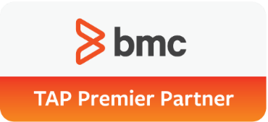
MOVÌRI AND BMC TRUESIGHT CAPACITY OPTIMIZATION
Movìri
F.K.A. Neptuny, original Creators of Caplan, acquired by BMC and rebranded to TrueSight Capacity Optimization
BMC Software Service Premier Partner
More than 10 years of experience in Capacity Management
200+ enterprise customers worldwide, managed the majority of Capacity Optimization implementations
TRUESIGHT CAPACITY OPTIMIZATION
Holistic Enterprise-Wide Capacity Management
Open, Flexible data model
Business-Aware Capacity Planning
Powerful Analytics
Automatic Data collection
Notes:
In the beginning – Neptuny who made Best1 a capacity Optimizing Software whit was GREAT.
BMC bought the product which has become TrueSight Capacity Optimization and Neptuny became Movìri The preferred consultancy for the solution.
BMC TrueSight Capacity Optimization is the best solution to perform modern capacity planning, due to:
Flexible and scalable to integrate virtually any source
Sophisticated analytics to provide visibility
Automatic integration with system-to-service mapping in a CMDB
Integrated business KPIs such as transaction volume and number of concurrent users are correlated to resource utilization

Slide 9
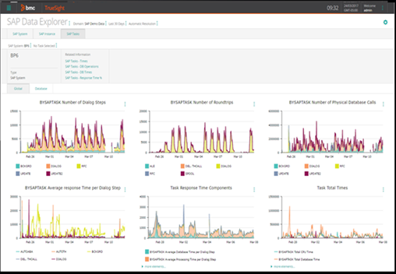
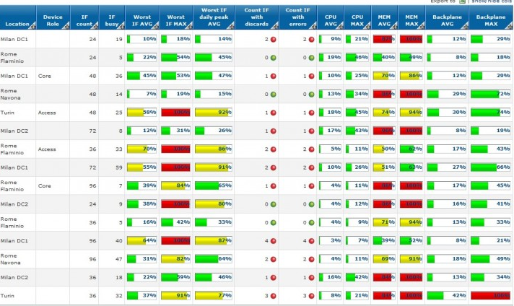
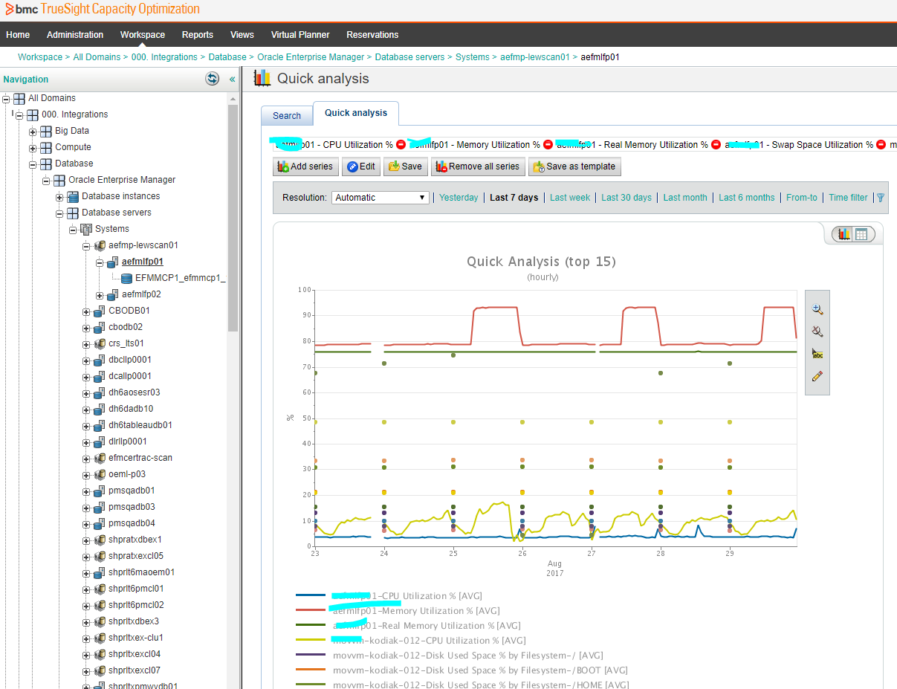
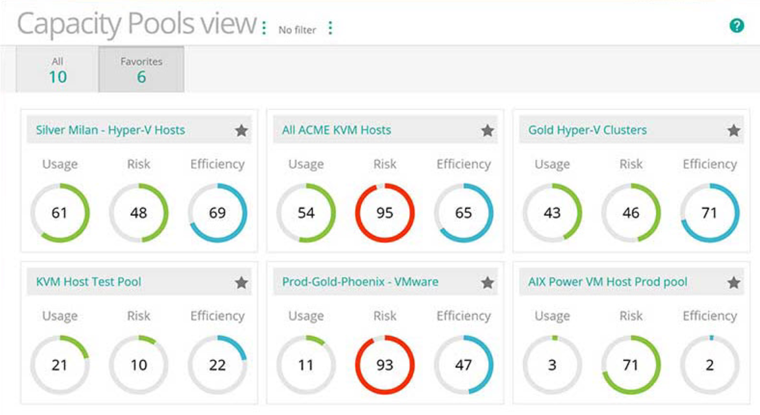
TSCO SAMPLE REPORTS
Notes:
Here are sample screens. What you should take from this is this is an established solution with advanced, mature capabilities.
And We can help you get value for your existing data.

Slide 10
MOVÌRI SOLUTION

Slide 11
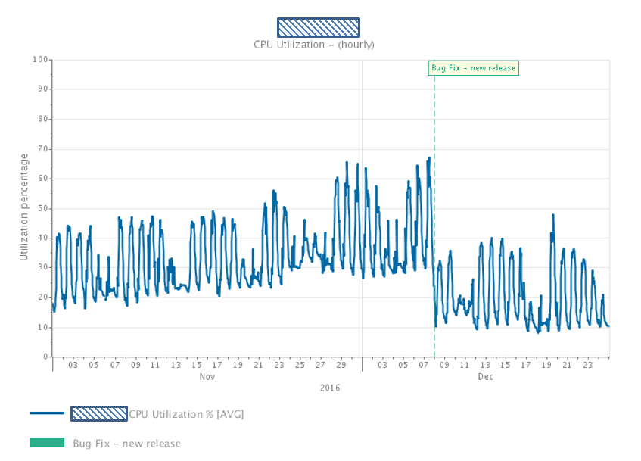
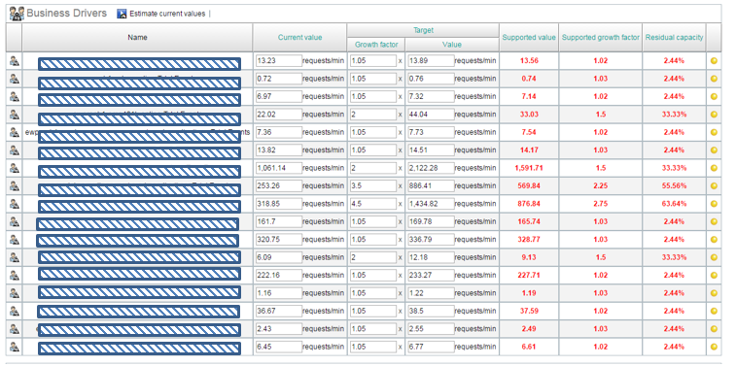
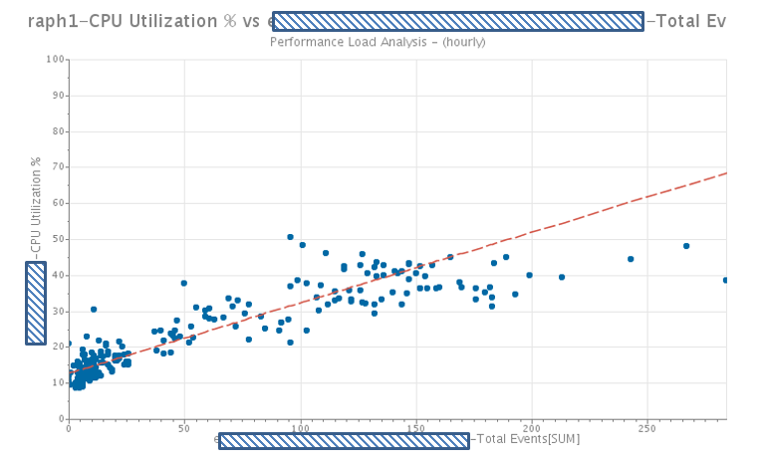
GO BEYOND SIMPLE CAPACITY MODELS
UNIVARIATE MODELS
MULTIVARIATE ANALYSIS
Ability to isolate individual components and simulate independent changes
Simple metric over time
Univariate metric vs business driver correlation
Notes:
Why is what I am doing now not good enough….
The business need is to go beyond simple capacity models.
As a capacity team matures, simple metric over time and relatively simple metric vs business drivers correlation studies no longer provide sufficiently nuanced capacity models.
In order to predict resource consumption based on multiple, independent inputs, that is to say multiple business processes, Multivariate Analysis is the tool to use.
Multivariate Analysis allows the analyst to determine the resource consumption (CPU, Memory, Storage, etc.) of a system based on each of the business processes that use that system. If different sized business process are going to triple over the next year while another doubles, and one decreases slightly, what is the impact on the systems that service those business processes??
Answering complex capacity questions like this, quickly and accurately, is the business need.

Slide 12
IT IS NOT MAGIC – IT IS MATH AND STATISTICS
A definition of multivariate analysis (MVA) is “a statistical procedure for analysis of data involving more than one type of measurement or observation. It may also mean solving problems where more than one dependent variable is analyzed simultaneously with other variables”.
Utilization Law / Little’s Law
Notes:
A definition of multivariate analysis (MVA) is “a statistical procedure for analysis of data involving more than one type of measurement or observation. It may also mean solving problems where more than one dependent variable is analyzed simultaneously with other variables”.
When applied to IT Capacity Modelling, MVAs are one of the most powerful analytical tools as they provide a framework capable of predicting the resource consumption (e.g. utilization of CPU) starting from multiple, independent inputs (e.g. different business processes). This technique is the most suited to support what-if scenarios for:
- Increase application density: select which applications or components can be hosted on the same infrastructure without compromising performance OR
- Evaluate the impact of business events on shared infrastructure (increase in userbase, sales quotes, online check-ins, etc.)
Yes there are formulas to describe the problem. But it is not hard or magic. It is Math and Science.
===
Where base utilization is the amount of utilization that cannot be explained by simply looking at utilization and business driver
https://docs.bmc.com/docs/display/btco107/Business+driver+map
http://sphweb.bumc.bu.edu/otlt/mph-modules/bs/bs704-ep713_multivariablemethods/BS704-EP713_MultivariableMethods_print.html

Slide 13
FIRST STEP
ELICIT MINIMUM REQUIRED CAPABILITIES
DEFINE SUCCESS
ASSESS THE AS-IS
Do a complete job.
Missing relevant data here costs much more to fix later.
Notes:
First step
Elicit the list the minimum required capabilities. Talking with the business, taking care to gather relevant information and practice active listening.
Define success,
inventory tools, inventory equipment, data sources, application structure, relevant business metrics, association tables and relevant business plans and opportunities.
Do a complete job. Missing relevant data here costs much more to fix later.

Slide 14
SECOND STEP
DATA SOURCE INVENTORY
DATA QUALITY EVALUATION
SKILLS, TOOLS, PROCESSES
Be Careful.
The cost of introducing questionable data causes significant, and hard to detect, harm to the process.
Notes:
Second step
Assess available resources.
Evaluating data sources and determining that they are not suitable to a given purpose is difficult and complicated, but the cost of introducing questionable data causes significant, and hard to detect, harm to the process.
Evaluate the available tools, infrastructure, business information, and opportunities to evaluate the overall success feasibility.
Be Careful. The cost of introducing questionable data causes significant , and hard to detect, harm to the process.
====
The more relevant tasks are:
-Validate all relevant applications are monitored by AppDynamics - supplying business metric data, system metrics, and association data, etc.
-Validate BMC TrueSight Capacity Optimization (TSCO from now on) is correctly configured and ingest required VMWare and OS monitoring data.
-Validate a custom ETL (Extract, Transform, and Load) operation can be designed and implemented to ingest AppDynamics data into TSCO.
-Validate actual CMDB coverage for the applications in scope and service model accuracy.

Slide 15
THIRD STEP
DESIGN AND IMPLEMENT INTEGRATION OF DATA SOURCES
ENRICH SERVICE MODELS
VALIDATE CORRECTNESS
IDENTIFY MOST APPROPRIATE CORRELATIONS
RISOLVE AS-IS ISSUES
Caution. Here is where you pay for mistakes
Notes:
Third step
-Resolve any issues.
As the consultant we provided guidance, expertly applied tools and techniques of the various tools, and leveraged the available data, to deliver actionable intelligence:
- Improve existing tool configuration, such as all relevant data must be collected using appropriate measurement units and made available to external tools.
- Improve quality of CMDB data and service model accuracy. The application owner is responsible to ensure the applications being studied are complete and accurate.
- Design, implement and validate a custom integration between AppDynamics and TSCO, covering:
Performance metrics
Business transaction volumes
Service Models, dependencies, and relationships
- Enrich service models by defining tags and additional grouping criteria, facilitating the model definition.
- Validate the correctness of analysis configuration by comparing the outcome of analysis to current data. Introducing errors in the analysis will adversely affect the accuracy of forecasts, forcing one to a spend a considerable amount of time in fixing it.
Identify the most appropriate correlations between observed entities and metrics to provide options based on multiple KPIs.
Caution here is where you pay for your mistakes.

Slide 16
THE IMPORTANCE OF A STEADY STATE
Not a Steady State
Resolved
Notes:
We looked for a representative, steady state to be the basis of our analysis. What we found was not that. This situation needed to be addressed and corrected.
Failing to correct this significantly reduces the models accuracy (over steady state)
The problem was identified and corrected.
Now we have a steady state. And this new state was determined to be a valid representation of ‘normal’ operations.

Slide 17
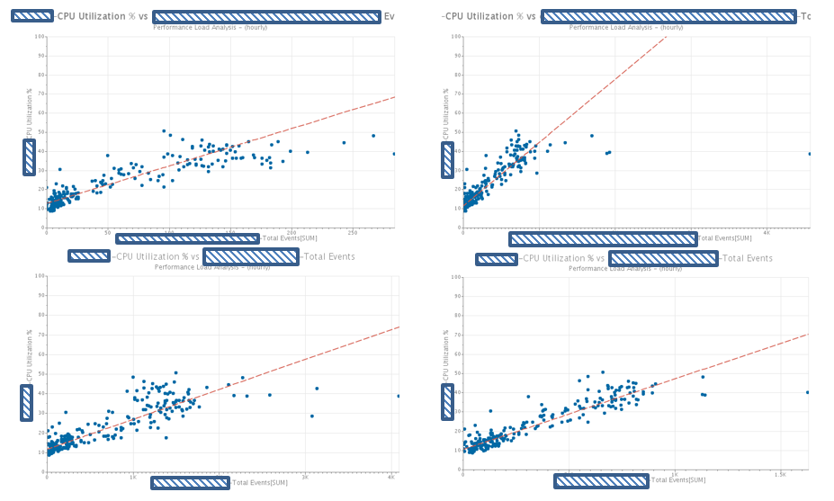
EVALUATE CORRELATIONS
Notes:
We started analyzing individual correlations to find the most significant.
Each workload were evaluated, anomalies examined.
Results given considerable scrutiny and found that there was a tight correlation between the workloads and CPU. It was determined that straight line regression were appropriate for these workloads, despite the slight leveling out after a critical amount of transactions per period.

Slide 18
EVALUATE CAPACITY
SET A BASELINE THE NATIVE GROWTH RATES
WHAT IF ANALYSIS
WORST SCENARIO ANALYSIS
Insignificant metrics may be significant in aggregate
Notes:
To evaluate the capacity, we started with a base forecast of 90 days. That did not violate thresholds, meaning that without the expected business change, there is not an appreciable change to the environment for the near future. This is important to determine ‘native growth rates’, and to set a baseline.
Then we moved to What IF analysis to evaluate the system behavior under different increased workloads.
The worst scenario considered an increased workloads of 500% on target metrics (10% the other ones). As result, only CPU violate thresholds but not memory, storage or disk IO.
This suggested that even with higher than expected growth the only resource driven above thresholds is CPU. These sorts of analysis are important to be sure that key resources are not overlooked.
In our model we accounted all workloads, not only target ones since insignificant metrics may be significant in aggregate.

Slide 19
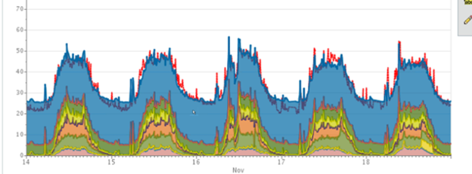
ACTUAL vs FORECASTED – SUCCESS!
Red line at top is forecast. Stacked area data are actual.
Notes:
Eventually, multivariate models are created, run and analyzed then compared against real data. The deviation from predicted vs reality indicate the reliability of the model. In our case, we achieved significant overlap, suggesting the model is accurate.

Slide 20
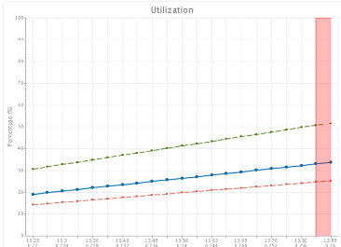
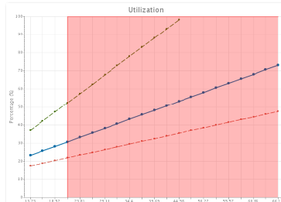
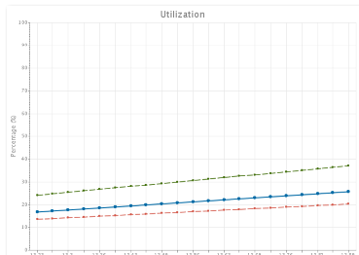
WHAT IF SCENARIO
Notes:
Walk through what if scenarios. Not just the one expected, but several.
Like all loads change at the same rate,
or some loads change more than the official scenario,
or much more than the official scenario,
or in a different mix than the official scenario.
as well as accounting for unrelated business marketing efforts, or seasonal spikes or other anomalies.

Slide 21
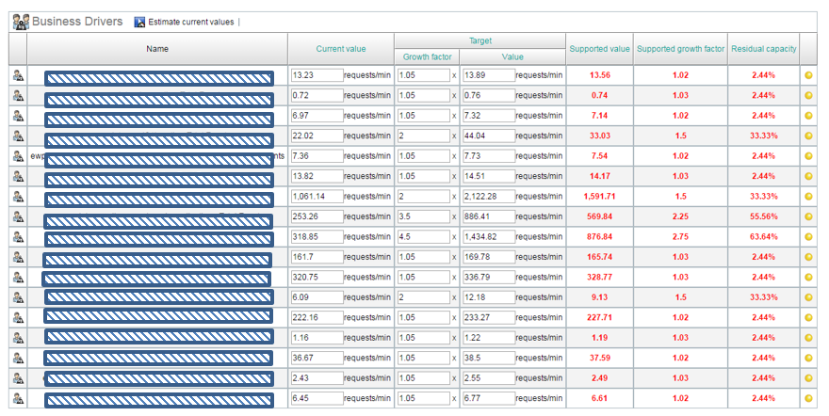
OFFICIAL MODEL SCENARIO
Notes:
Here is a model of the official scenario
Notice most workloads increased by ‘normal’ amounts 5%. Some have high transaction counts.
Some grow by 2x, 3.5x and 4.5x. Modeling these across the relevant devices delivers the ‘answer’ based on each individual scenario.
Dozens of these are created, analyzed, validated and assigned a cost. (Cost is not only money. Time, operational risk, business risk, impacts to users, and a host of other non monetarily costs are considered.)

Slide 22
NOW WHAT OPTIONS ARE APPARENT

Slide 23
OPTIONS
OPTION 1 DO NOTHING
OPTION 2 WORKLOAD MIGRATION
OPTION 3 SCALE VERTICALLY
OPTION 4 SCALE
HORIZONTALLY
Notes:
Option 1 is the ‘Do Nothing’ option.
Option 2 migrates the workloads to other infrastructure
Option 3 adds resources (CPU, Memory, configuration settings) to existing systems. There are natural limits to this.
Option 4 adds new resources like new equipment.

Slide 24
OPTION 1 - FOCUS ON THE “DO NOTHING OPTION”
Clarifies and galvanizes the need for action (or not).
Gives a baseline for ‘costs’ (more than monetary)
Defines the boogie man – reducing the FUD dragons
OPTION 1 DO NOTHING
Notes:
Option 1 – Keep it as it is
Is the ‘do nothing’ option. This had a high likelihood to result in a CPU bound device that would negatively impact response time during peak use and would negatively impact several unrelated applications, as well as the target application.
Note that it is helpful to explore the do-nothing option first and in detail, as this crystallizes what the impacts and costs of doing nothing are. As the likelihood is large, and the negative impact is large, and the cost to customer satisfaction and reputation is large, people were motivated to ‘do something’, and had a cost to compare the other options against.
F.U.D. = Fear, Uncertainty and Doubt

Slide 25
OPTION 2 – WORKLOAD MIGRATION
Shift Loads to existing devices, with little financial impacts
Requires moving, existing services, equipment, firewall rules, network changes
Significant configuration changes to all devices and applications
OPTION 2 WORKLOAD MIGRATION
Notes:
Option 2 – Workload Migration
Is to shift other loads to different devices. This had little financial impact as the equipment was on site but not in the ‘proper place’ on the network.
Implementing this required moving existing services to other devices, physically moving the devices to the proper network segments, and configuring traffic.
This option has significant configuration changes to existing applications, firewalls, load balancers, networking and redirecting traffic of other applications to these devices.

Slide 26
OPTION 3 – SCALE VERTICALLY
Add CPU, some financial impact
No config or network changes
Removes much of the reserve capacity
OPTION 3 SCALE VERTICALLY
Notes:
Option 3 – Scale Vertically
Is to add CPU to the existing named devices (a virtual device hosted on large physical hardware). This had some financial impact as some of the (unrelated) software licensing is CPU driven, but this has less configuration changes, therefore less operational risk than Option 2. However, this removed much of the reserve capacity of the physical device.

Slide 27
OPTION 4 – SCALE HORIZONTALLY
Speeds up existing long term project.
Significant current year budget impact (e.g. project plan, network design, system administrators, network engineering)
This was assumed to be the answer
OPTION 4 SCALE
HORIZONTALLY
Notes:
Option 4 – Scale Horizontally
This Is to speed up an underway project of a major software revision that will add devices and reconfigure how parts of the application work.
This project is a year plus from being ready, and involves some planned equipment expenditures. Speeding up this effort hardware wise, has significant financial planning impacts, complicates the eventual rollout of the upgrade, and all the manpower effort and configuration risk of Option 2.
It is interesting to note that this exercise allowed the customer to avoid speeding up option 4 which is work in the pipeline, and was assumed to be the answer before the capacity planning exercise. For the record, it was assumed that there was not enough reserve CPU to handle the increase, based on simple capacity estimates of tripling the entire load on the existing servers. The ability to do multivariate analysis showed that increasing specific loads (not all) allowed the business to choose the less impactful choice with confidence.
This was assumed to be the choice but we did not wish it. While the systems and network are planned to be redesigned in the coming year there is not manpower, budget, or completed designs to do this quickly.
In short had all the down sides of the other options.

Slide 28
OPTION SELECTED
OPTION | DOLLAR COST | EFFORT | RISK | BUSINESS IMPACT
1 | $ | $ | $$$$$ | $$$$$$$$
2 | $ | $$$$$$ | $$$$$$ | $$$$$
3 | $$$ | $ | $$ | $$
4 | $$$$$$$ | $$$$$$ | $$$$$$$ | $$$$$$$$$$
Option 3 – Scale Vertically was chosen as the most appropriate solution.
Notes:
Option 1 has a low dollar cost but a high business risk and business impact.
Option 2 did not cost much but introduced considerable risk, and took significant effort.
Option 3 had some cost but mitigated the effort, risk and business impact
Option 4 was exceptionally burdensome now as the plans were not yet in place. And was scheduled for a year from now. Speeding this up would be expensive.
Option 3 – Scale Vertically was chosen as the most appropriate solution.

Slide 29
RESULTS

Slide 30

SO WHAT HAPPENED?
Successfully bridged to the already schedule environment redesign
Immediate business case was solved with limited expense and disruption
Option 4 was avoided until regularly scheduled implementation.
“We were pleasantly surprised that we could minimize impact and not interfere with our redesign program. Very happy with the result.”
Notes:
So what happened.
In this case option three successfully bridged to the already scheduled environment redesign in a controlled way.
The immediate business case was solved with limited expense and disruption, the customers users were happy with the new functionality and response times, and life was good.
Option 4 was the expected outcome and the customer was happy that it was able to be delayed until all of the political , financial , and project management issues were resolved. All in all an excellent result.

Slide 31
LESSON LEARNED – 4 KEY TAKEWAYS
Multivariate analysis is an effective tool for solving business questions.
Skillful application of tools and techniques allow:
Additional value from existing data sources
Avoiding unnecessary disruption
Accurately modeling in a complicated environment
This value was delivered quickly, in an audible, repeatable way, using built in features
Actionable intelligence is achieved with smart use of tools and data, and in coordination with the business. Exactly what is needed to run IT like a business.
Notes:
In Summary The lessons learned is that multivariate analysis is an effective tool for solving business questions.
Skillful application of tools and techniques within the Capacity Optimization tool allowed additional value from existing data sources. Avoided unnecessarily activating a future plan to accommodate a short-term business opportunity, while accurately modeling a complicated impact to existing applications in a complicated environment.
This value was delivered quickly, with data driven deaccessioning, in an audible, repeatable, way, without programmatic changes to any of the systems or applications involved, using built in features.
This actionable intelligence, is achieved with smart use of the tools and data available along with detailed conversations with the business. Exactly what the experts say is needed to run IT like a business.

Slide 32
QUESTIONS & ANSWERS
Can’t think about anything now? Shoot us an email!
ben.davies@moviri.com
andrea.vasco@moviri.com

