Slide 1
BMC Capacity Optimization (BCO)
Overview
In 13 minutes or less
(more if you read the presentation notes)
Notes:
This is a quick overview of the BCO tool (BMC Capacity Optimization). Covering the basic function from a technical point of view and focusing on the Workspace Tab.

Slide 2
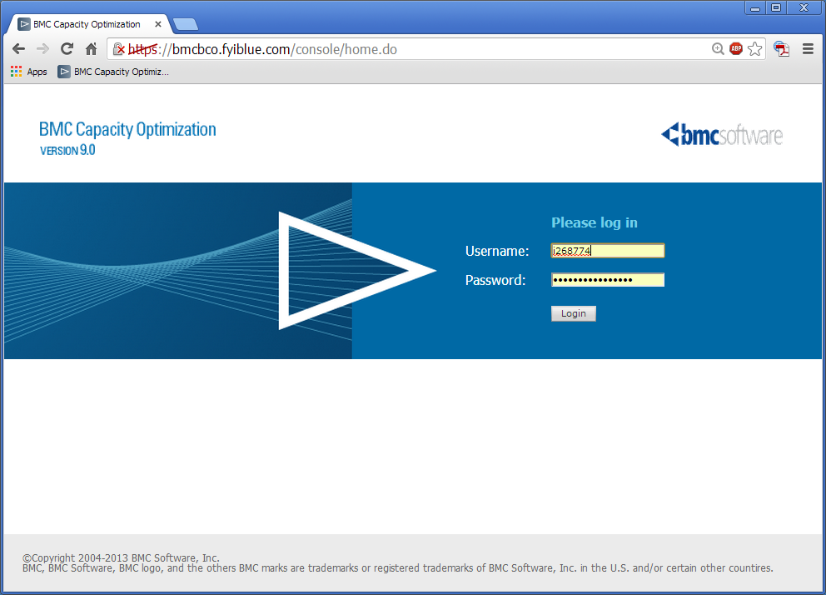
Login to the tool.
https://bmcbco.fyiblue.com/console/
AccessNow! Request BCO Viewer
LAN Username and Password.
Notes:
AccessNow! Request to the group BCO Viewer.
Also may request BCO User (allows ability to change Workspace reports and charts).
Login with LAN ID and Password
AccessNow! Become the user of record
Submit | Windows | Add Access
Domain is ADHCSCINT
Search for BCO Select BCO Viewer (or BCO User, or BCO Admin as appropriate)
Justification text..
BCO Viewer
BCO access is necessary to perform duties specific to monitoring the infrastructure and or application data available in the BCO tool. This access is mostly read only, and is to retrieve data for analysis and use reports available through the BCO tool.
BCO User
As part of a capacity planning role, access to this group grants access to the BCO capacity planning tool. This is required to perform duties as capacity planner and includes creating reports, creating analysis, and monitoring the infrastructure and or application data available in the BCO tool.
BCO Admin
This access is needed to gain administrative control of the BMC Capacity Optimization (BCO) software. This software collects monitoring data and business data then combines them into various groupings (application, services, etc.) This data then can show performance over time and to forecast capacity. These outputs directly support application owners, project managers, and infrastructure managers.

Slide 3
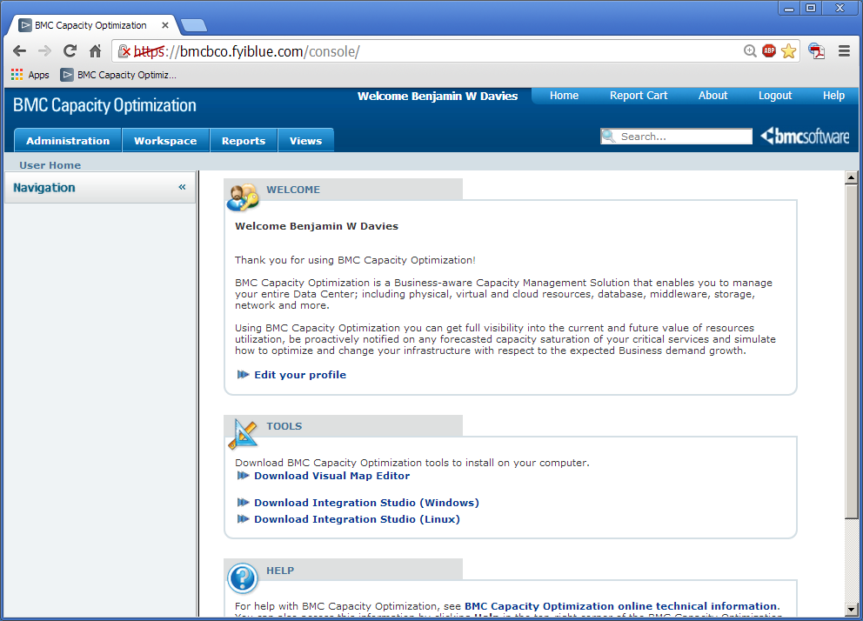
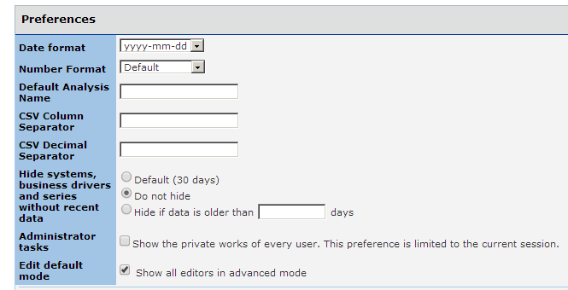
First Time Setup (or not)
On the Home screen,
click “Edit your profile”
Choose Date format
Choose data hide choices
Choose edit mode
Notes:
The first time, setup your preferences (or not).
Know that you have control over the date format. That you have hidden systems and business drivers that do not have data for the last 30 days (which is why your screen may not show the same as someone else's).
If you edit charts the advanced mode is active by default or not.

Slide 4
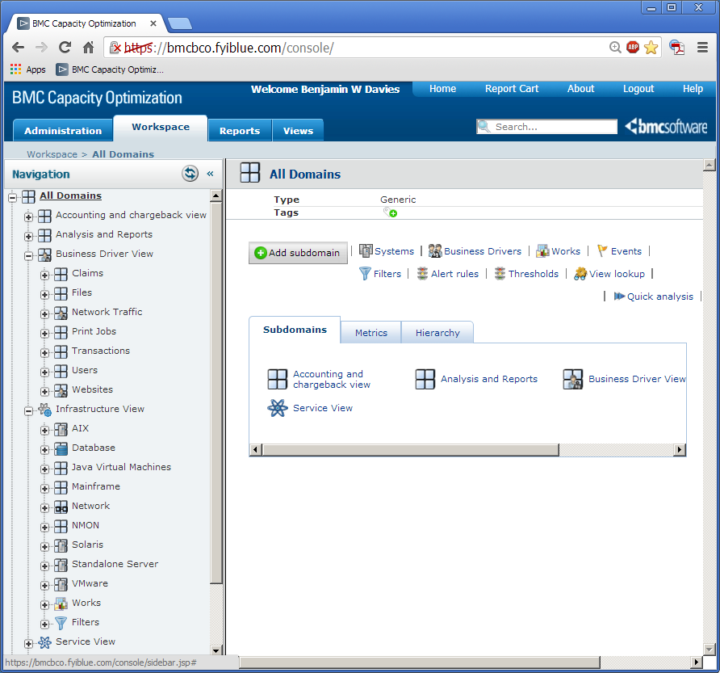
Overview in 13 Minutes or Less
Home
Search
Views Tab
Reports Tab
Workspace Tab
All Domains
Business Driver View
Infrastructure View
Service View
Work Window
Notes:
Home is helpful as is ‘forgets’ which trees you had open. This is helpful when you have opened a lot of trees and BCO remembers that to be helpful, which it mostly is but when it is not… Home will collapse the trees and let you ‘start fresh’.
Search is a power full search. Something like this. (page 1536 in the manual)
(-domain:NMON AND +domain:AIX) AND (metric:cpu* -type:object) gives 46 devices Reversing the domains shows 0 systems.
Views Tab – ready made reports driven by selection menus. Not much to edit.
Reports Tab – Ready made reports already run. Implies mature reports that are scheduled.
Workspace Tab – Where reports and interactive analysis is done. As reports mature they are ‘moved’ to Reports tab or Views tab.
All Domains – The ‘master’ domain
Business Driver View – Where the business drivers are kept. These are counts of work, like claims, members, calls, print jobs, web visits etc.
Infrastructure View – Where the device metrics are kept. These are CPU, Memory, Disk IO, Storage space and other device resources that do the work (the business drivers)
Service View – Where the work and the devices that do the work are combined. Once combined correlations can be made (device metric to device metric, device metric to work unit, work unit to work unit) and historic trends established (device metrics over time, work unit over time) and forecasts made based on correlations, history and ‘what if’ scenarios.
Work Window – The space where the report, charts and work is done.

Slide 5
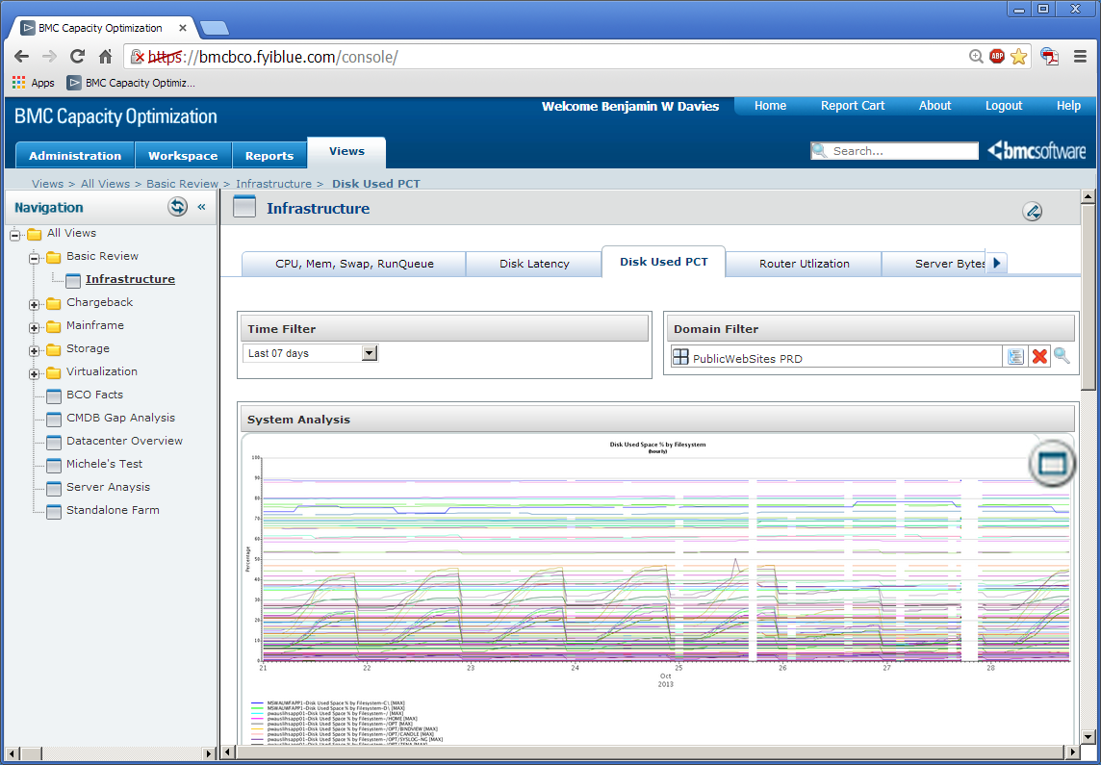
Views Tab
Search:
Try sys:*app01 –type:object or
(-domain:AIX AND (metric:cpu* -type:object)
Views.
Select a report.
Choose a report type.
Select options. Search.
Get a chart or report.
Notes:
From the left. A search option. Very powerful if used creatively.
The Views tab. A place for ‘reports’ that allows for multiple selections. Very little edit ability beside selecting filters.
This view shows an infrastructure report of Disk Used as a Percent, for Public Websites Production over the last 7 days.

Slide 6
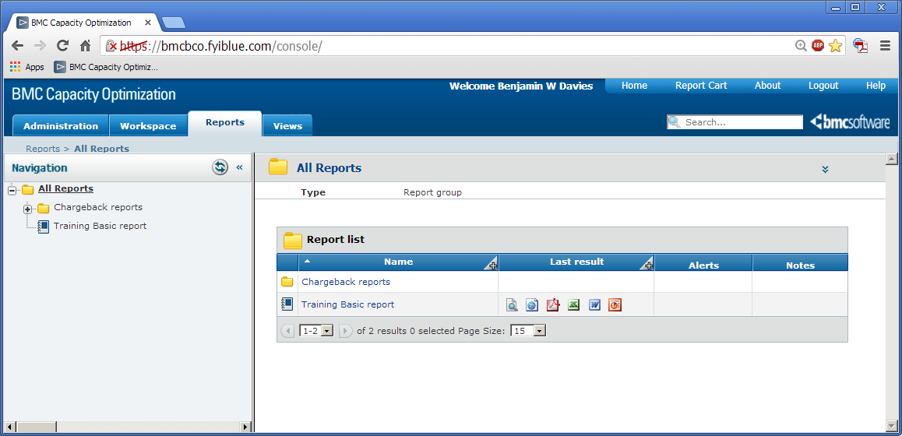
Reports Tab
Reports tab is for mature reports that are scheduled and here to be ‘picked up’. This is the last tab to mature.
Notes:
The Reports tab is where mature reports are placed. Normally these reports are scheduled (weekly or monthly) and placed here for review. This is the last tab to mature as the reports need to mature to be placed here.
Many report take some time to run so these are scheduled to run off hours and placed here.

Slide 7
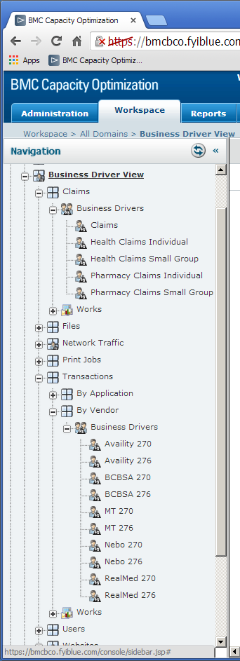
Business Driver View
Business drivers are any count of work, and can come form any source. While database sources are preferred, (read only) any structured data source can be used. Some of these data sources are comma separated files that are loaded as the data is available. Other data sources are report databases, WebTrends reports read as a simulated web user, and spreadsheets.
Current data includes counts of members, counts of claims of various types, network traffic, print jobs, vendor files of different types. The data you use is important as well and we would like to have an automated way to get that as well.
These data points can be compared with the devices that actually do the work and can be compared with other business metrics or day of the week time of day etc.
Detailed data is aggregated into bigger and bigger time chunks and kept for a long time for trend analysis.
Notes:
Business drivers are any count of work, and can come form any source. While database sources are preferred, (read only) any structured data source can be used. Some of these data sources are comma separated files that are loaded as the data is available. Other data sources are report databases, WebTrends reports read as a simulated web user, and spreadsheets.
Current data includes counts of members, counts of claims of various types, network traffic, print jobs, vendor files of different types. The data you use is important as well and we would like to have an automated way to get that as well.
These data points can be compared with the devices that actually do the work and can be compared with other business metrics or day of the week time of day etc.
We like 15 minute data but any granularity is helpful. This detail is good for correlation but the BCO is not a monitoring tool and will not displace any monitoring tools.
Database queries are the easiest to setup and maintain and can be scheduled to run as often as helpful (once a day is typical). Metrics can be made ‘on the fly’ and stored in the BCO database.
Detailed data is aggregated into bigger and bigger time chunks and kept for a long time for trend analysis.

Slide 8
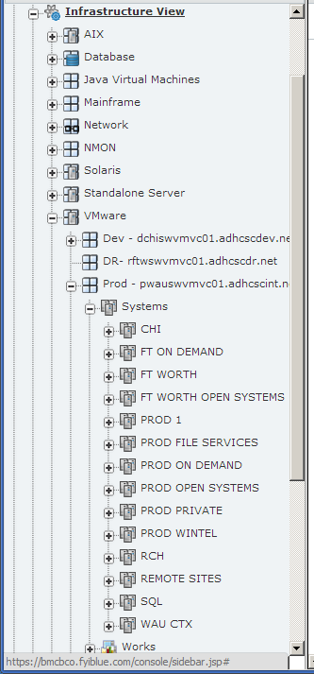
Infrastructure View
Infrastructure data is any kind of system monitoring data and can come from any source. While database sources are preferred, (read only) any structured data source can be used. These data sources are the HP Performance Insight monitoring tools, Database monitoring tools, mainframe, and VMWare management tools. We look forward to adding MQ data, ODS metrics, NetQOS and any monitoring data you use, we would like to have an automated way to get that as well.
These devices can be compared to the business work that is done on the devices or over time to correlation and trends.
We like 15 minute data but any granularity is helpful. This detail is good for correlation but the BCO is not a monitoring tool and will not displace any monitoring tools.
Notes:
Infrastructure data is any kind of system monitoring data and can come from any source. While database sources are preferred, (read only) any structured data source can be used. These data sources are the HP Performance Insight monitoring tools, Database monitoring tools, mainframe, and VMWare management tools. We look forward to adding MQ data, ODS metrics, NetQOS and any monitoring data you use, we would like to have an automated way to get that as well.
These devices can be compared to the business work that is done on the devices or over time to correlation and trends.
We like 15 minute data but any granularity is helpful. This detail is good for correlation but the BCO is not a monitoring tool and will not displace any monitoring tools.
Database queries are the easiest to setup and maintain and can be scheduled to run as often as helpful (once a day is typical). Metrics can be made ‘on the fly’ and stored in the BCO database.
Detailed data is aggregated into bigger and bigger time chunks and kept for a long time for trend analysis.

Slide 9
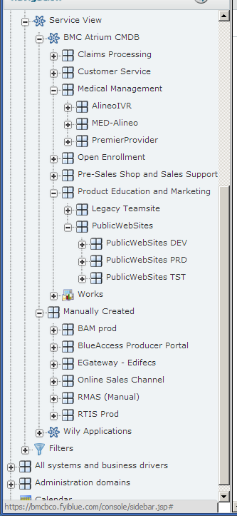
Service View
Service view takes Business data and combines it with the Infrastructure data in ways that are just not feasible without a tool like the BCO tool.
The main way these associations are made is by the Configuration Management Team making application and services in the Configuration Management Database (CMDB) which BCO will import. Other associations are manually created by the BCO admins to service the requests of BCO customers.
Once combined, correlations can be made (device metric to device metric, device metric to work unit, work unit to work unit) and historic trends established (device metrics over time, work unit over time) and forecasts made based on correlations, history and ‘what if’ scenarios.
Notes:
Service view takes Business data and combines it with the Infrastructure data in ways that are just not feasible without a tool like the BCO tool.
The main way these associations are made is by the Configuration Management Team making application and services in the Configuration Management Database (CMDB) which BCO will import. The CMDB makes associations that are not sent to BCO at the moment such as routers but other associations are not yet made such as switches (they are not seen in the data communication paths). Eventually, as the model mature these associations may make it to BCO so they can be incorporated, however, at the moment this level of detail is not helpful.
Other associations are manually created by the BCO admins to service the requests of BCO customers. As the CMDB makes these associations they manual associations will be removed but these associations can be any groups of devices useful to study as a group, which means a ‘made up application’ can be created and analyzed against any other available data.
Once combined correlations can be made (device metric to device metric, device metric to work unit, work unit to work unit) and historic trends established (device metrics over time, work unit over time) and forecasts made based on correlations, history and ‘what if’ scenarios.
These scenarios are informed with SME knowledge with the correlation scores and understanding of business interactions, business plans and business contingencies. Models can take quite some time to develop and work through but are based on the ‘math and science’ of the data available, so are assumed to be reliable indicators.

Slide 10
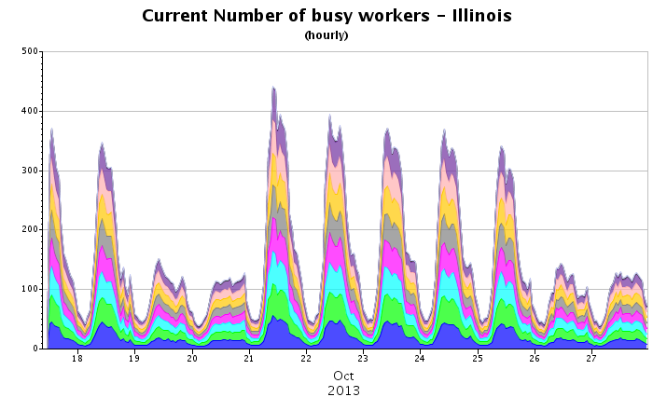
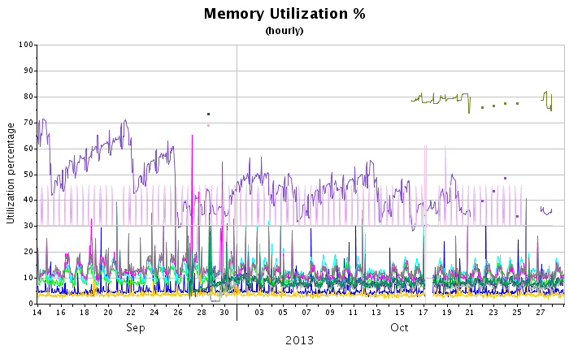
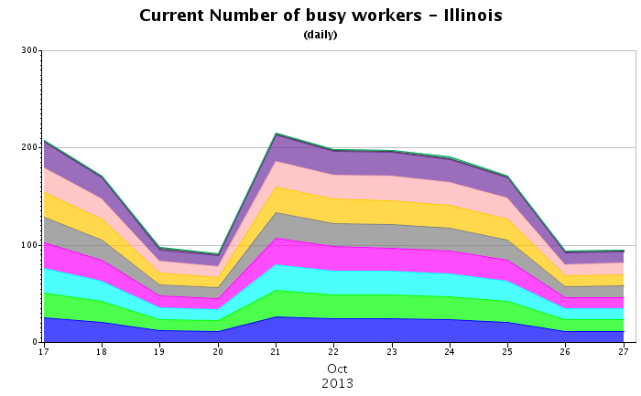
Basic Metric Trending
Device metrics and business metrics can be trended in detail to show short term trends and in larger time slices to show longer term trends.
Notes:
Basic trending can be done with device metrics as well as business metrics and is the least interesting reports you get from BCO. Anyone with this data now can create these reports now, but they are not related to any other data so while they may be interesting on their own, they are much more interesting when combined with other data, trends, and observations.
In the examples memory is a device metric while ‘busy workers’ is a business metric and more exactly a proxy for concurrent web users (on the Illinois web site). The hourly chart shows variation within the day while the daily chart of the same data for the same time shows trend over the week. Longer time frames and larger aggregates offer yet different views of the data.

Slide 11
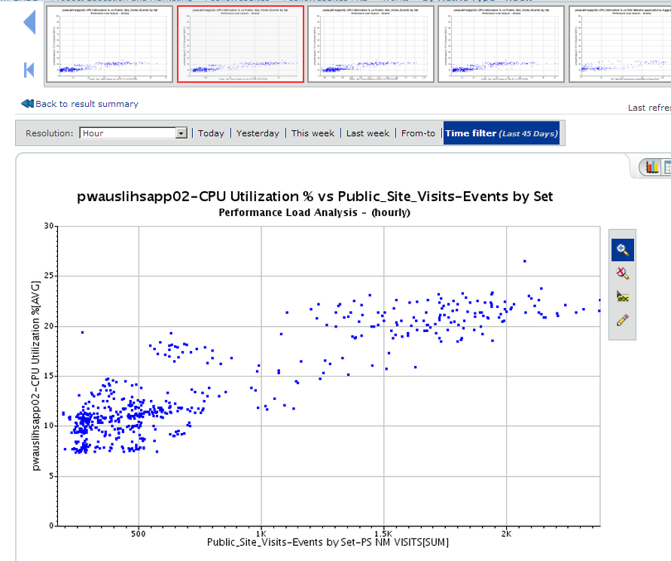
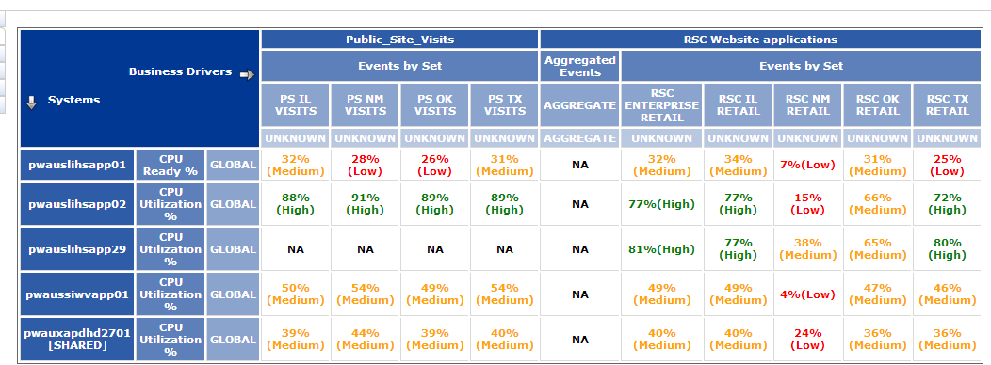
Correlation Map
A high correlation suggests that the two metrics are closely related. As one moves, the other moves in a predictable way. This implies that as Public Site Visits increase CPU Utilization % on pwauslishapp02 increases at a predictable rate.
Notes:
A high correlation suggests that the two metrics are closely related. As one moves, the other moves in a predictable way. This implies that as Public Site Visits increase CPU Utilization % on pwauslishapp02 increases at a predictable rate.
Implied in this is that this predicts when a threshold will be reached as the work increases. SME and business knowledge temper these conclusions but the conclusions can be made. The more complete the data the more complete the model. The more complete the model the more reliable the result.

Slide 12
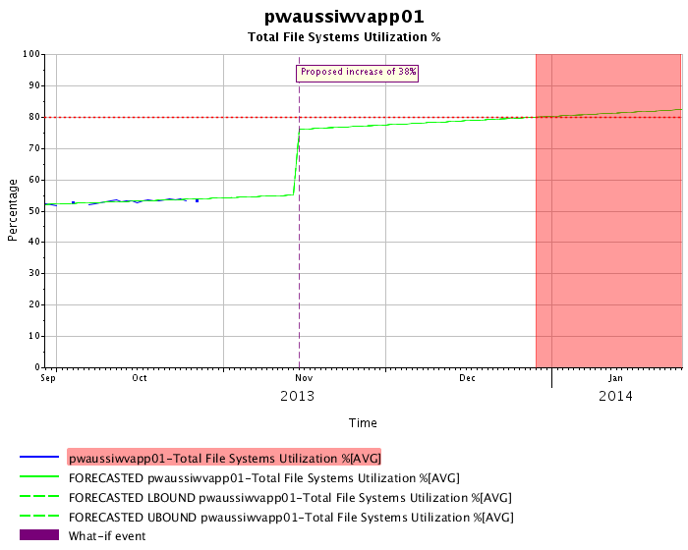
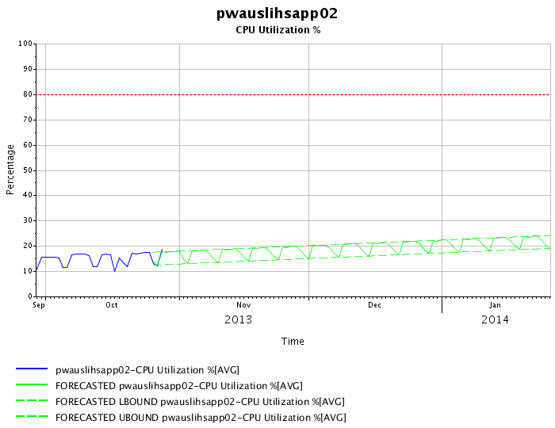
Generic Forecast and What IF?
Generic forecast shows not just average but peaks and valleys.
This what if scenario assumes a 38% increase on November 15th. And suggests the 80% threshold will be reached late December.
Notes:
Generic Forecasts will evaluate history and forecast the future. This can be device metrics or business metrics but implicitly suppose that the past is a reasonable predictor of the future. Or in other words, the future will not have influences not already seen in the historic data. Forecasts can seen monthly seasonality and yearly seasonality and make forecast accommodations for that. But, ‘black swans’ or other un usual events will not be accounted for.
What if scenarios will predict just as generic forecast will but can insert unusual events. These events can be increases or decreases and several can be incorporated into a model. The correlation analysis will help equate a predicted increase in one metric to the impact on other metrics making the models flexible for forecasting indirect metrics. Again, the more complete the data the more complete the models, and these models are complex and take considerable time.

Slide 13
Overview Summary
BMC Capacity Optimization - BCO is a capacity tool (not a monitoring tool), that can use nearly any structured data currently available (read only, automated access preferred).
BCO combines this data for correlation, comparison, analysis and reporting.
The data you use for analysis is of interest to the BCO group for inclusion to the BCO tool.
The BCO tool is a capacity tool but the correlation, comparison, analysis and reporting features could be of benefit to more than just capacity planning.
You are welcome to use the BCO data and tool, and we would like to have access to your data for inclusion to BCO.

