Slide 1

Actionable Intelligence and How “Good Enough” Can Take You from Manual to Millions
September 8, 2016
Mr. Ben Davies
Senior IT Business Consultant
Twitter @MrBenHoney
We make considerable use of the notes section. Download this presentation
Notes:
Welcome, we will start in a minute… at exactly 11:00
Welcome to the “Actionable Intelligence and How “Good Enough” Can Take You from Manual To Millions”
This is a conversation, we hope you participate in, to discuss how we went from manually gathering data and manipulating it with Excel to reporting on millions of a month in show back and much more. We will discuss briefly our lessons learned and useful tools the most important are the concepts of ‘good enough is good enough’ and incremental improvement or ‘suck less’ is critical to making progress.
There is an understanding that the metric data are an indicator vs. a proof. That is to say metric data can only indicate that something is true. Metric data can not prove something is true.
If you were expecting something else, you are in the wrong room, but we are glad to have you.
======
https://bmc.g2planet.com/bmcengage2016/public_session_view.php?agenda_session_id=86
Actionable Intelligence and How “Good Enough” Can Take You from Manual to Millions
Session ID:
702
Date / Time:
Thursday, September 8, 11:00 am - 11:45 am
Room:
Ironwood 7
Description:
Join this discussion to learn about Health Care Service Corporation’s (HCSC’s) journey, from finding data under rocks and manipulating it with Excel to reporting on six million dollar (US) a month in “showback.” We’ll share lessons learned and useful tools and techniques that you can use today, regardless of where you are on your journey. While our examples are specific to BMC TrueSight Capacity Optimization, they apply to most optimization efforts.
We’ll cover the concepts of “good enough is good enough”, incremental improvement or “suck less,” and data as indicator vs. proof. We’ll strive to liberate your thinking on how you can get from where you are to where you wish to be.
Level:
Intermediate
Presentation Type:
Business
Product(s):
BMC TrueSight Capacity Optimization
Type:
Customer/Industry Breakout
Track:
Digital Transformation Best Practices
Speaker(s):
Ben Davies, Senior IT Business Consultant, HCSC
James Kistler, Capacity Manager, HCSC
Status:
Available

Slide 2
AGENDA
1
Introduction
2
Why Actionable Intelligence Matters
3
A Conversation About Our Journey
Call to Action / Questions!
Card with “Suck Less” on the back
© Copyright 2016 BMC Software, Inc.
Notes:
Our agenda today is simple.
A quick introduction,
discussion on why actionable intelligence Matters
and conversation on our journey.
We end with a call to action and questions. However, feel free to ask questions as they come up.
There will be some examples and our presentation makes extensive use of the notes field in PowerPoint. So be sure to give us your card with “Suck Less” on the back and we will send this presentation and materials to you.

Slide 3


Founded in 1936
More than 14.5 million members strong
Largest customer-owned health insurer in the United States, fourth largest overall
Provides health coverage through Blue Cross and Blue Shield ® Plans in Illinois, Montana, New Mexico, Oklahoma and Texas
Provides dental, life and disability insurance through Dearborn National
21,000+ employees, 60 local offices
State-of-the-art technology, including two Tier IV data centers —industry's highest reliability level
National footprint; multiple subsidiaries and lines of business
By Alanscottwalker - Own work, CC BY-SA 3.0, https://commons.wikimedia.org/w/index.php?curid=11648264
Notes:
Health Care Service Corporation, a Mutual Legal Reserve Company, an Independent Licensee of the Blue Cross and Blue Shield Association.
Founded in 1936. With 14.5 million members, 55 billion gross revenue, five Blue Cross and Blue Shield ® state plans (Illinois, Texas, Oklahoma, New Mexico, Montana), multiple subsidiaries and lines of business, 22,000 employees, 60 local offices, and two tier IV (4) data centers, we are big by any definition.
TIME Magazine states we are number 5 in their top 20 privately held companies. (June 2015)
http://time.com/3854318/largest-private-companies-america/
Download this presentation. There are links in the notes section the talks about how architecturally interesting this building is.
===
Data accurate to early 2015.
http://www.hcsc.com/
http://www.hcsc.com/hcsc_hq.html
http://en.wikipedia.org/wiki/Blue_Cross_Blue_Shield_Tower
Received Trustee award for the HCSC Blue Cross Blue Shield of Illinois (BCBSIL) headquarters vertical completion project from the Chicago Architecture Foundation in 2006
http://www.glasssteelandstone.com/PrinterFriendlyBuildingDetail.php?BuildingName=Blue%20Cross-Blue%20Shield%20Of%20Illinois%20Tower&LocationCity=Chicago&LocationState=Illinois&LocationNation=United%20States

Slide 4
Our purpose:
“To do everything in our power to Stand with
our Members in sickness and health.”
Our vision:
Drive competitive advantage via efficiencies and cost-effectiveness through IT optimization, simplification, and agile infrastructure & applications
Notes:
Our corporate purpose is “to do everything in our power to stand with our members in sickness and health” and the IT vision is to “drive competitive advantage via efficiencies and cost-effectiveness through IT optimization, simplification, and agile infrastructure and applications.”
We are using BMC TrueSight Capacity Optimization and other BMC tools to directly support our Corporate Purpose and Vision.
This is a shameless plug, but, HCSC is a good company, that tries to be a good company.
However, good software and good intentions are not enough. Effort must be exerted to apply the good software to achieve a goal. This effort is substantial, but effort is required. There is actionable intelligence to be gained, if you apply the tools and techniques presented in this session, and actually put them to use.
==

Slide 5

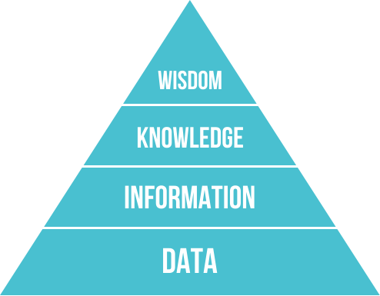
Why Actionable Intelligence Matters
Actionable Intelligence matters because you, as a good corporate citizen, are charged to gather relevant data, manipulate it into information, organize it into intelligence, and present it for action.
You are doing this now (probably)
Increase the time spent on high value activity.
(Top of the pyramid)
https://en.wikipedia.org/wiki/DIKW_Pyramid
“Suck Less” and “Good enough is good enough”
Notes:
Actionable Intelligence matters because you, as a good corporate citizen, are charged to gather relevant data, manipulate it into information, organize it into intelligence, and present it for action. Generally referred to as the DIKW Pyramid.
You are probably doing this now but (probably) not as effectively as you could.
We spent a LOT of time on the data and information levels before the senior managers began asking questions. But when those questions were being asked, we spent more time on the top of the pyramid, because we already had much of the data and information layers done.
“Good Enough is Good Enough” and “Suck Less” are concepts that specifically allow you to more quickly iterate through process improvement efforts.
Find a piece of data and mature it until it is ‘good enough’. Make reports and observations based on what the data indicates (the data does not prove). The reports and observations will include caveats and qualifiers. Make the data or analysis “Suck Less” by incrementally improving the data, information, knowledge and analysis. As the data, information and knowledge, gets better, your understanding of what the data indicates becomes better.
Anyway, ‘suck less’ and ‘good enough is good enough’ will be a reoccurring theme for us, AND can help you make progress.
===
https://en.wikipedia.org/wiki/DIKW_Pyramid
The DIKW Pyramid, also known variously as the "DIKW Hierarchy", "Wisdom Hierarchy", the "Knowledge Hierarchy", the "Information Hierarchy", and the "Knowledge Pyramid",^{[1]} refers loosely to a class of models^{[2]} for representing purported structural and/or functional relationships between data, information, knowledge, and wisdom. "Typically information is defined in terms of data, knowledge in terms of information, and wisdom in terms of knowledge".^{[1]}

Slide 6


Milestones in our Journey
  Problem Identified
  Identify the Data
  The Impossible Chart
  BMC Capacity Optimization
  Quickly mature
  Chargeback for projects
  Retire Servers
  Application Charge Back and Beyond
Good Enough is Good Enough
Suck Less
Notes:
Our basic journey had these milestones.
Problem Identified.
Identify the data.
The Impossible Chart.
BMC Capacity Optimization.
Quickly Mature.
Chargeback for Projects.
Retire Servers.
Application Charge Back and Beyond
We started with a clear idea of what the ‘end state’ would look like but no idea what path we were going to take. Our path was, and still is, an iterative organized mess, littered with changing priorities, changing leadership, territorial politics and basic chaos.
Or stated another way, a normal business environment.
At each point, we strived for “good enough is good enough” and “suck less”
===
====
Problem Identified. Our Journey begins with a VP not being happy with the level of reporting specific to the Corporate level for information technology. He could get reports on individual pockets of technology but not a big picture and definitely not a picture of costs of services provided by pockets.
Identify the data. We looked inside silos, under rocks (territorial minded managers), and leveraged other data sources, mostly without drawing too much attention to our selves. Put it in Excel. Conducted our own analysis and made reports. Based on the hostility the report received, we were threatened or schooled or both. Then pursued better data and better understanding for our analysis which made for better reports.
The Impossible Chart.
We were challenged with an impossible chart (we will show that later)
BMC Capacity Optimization. After some time we found the BMC Capacity Optimization tool (we started on 9.x). This was less of a sea change and more of a tool change as we were a couple years into our mission.
Quickly Mature. BMC allowed us to quickly mature as we really did out grow our tools and techniques, and had a pretty clear idea of what we wished to produce.
Chargeback for Projects. This allowed us to do basic charge back and took over the labor intensive job of project cost accounting.
Retire Servers. Our efforts informed a lot of senior people of the cost of infrastructure. This knowledge and some leadership changes allowed the first concentrated effort to retire servers. We, for the very first time in our 70 year + history retired more servers than we built for a couple months of that year.
Application Charge Back and Beyond. Now we are doing application charge back or more of a shame back. Comparing the cost of different applications and application portfolios throughout the business. We show back several million dollars a month.

Slide 7
Problem Identified
Why is Information Technology SOOO EXPENSIVE??
We have no way to SHOW how much a service costs
Direct Cost, loaded cost, fully loaded cost, or recovery target
<< Goal Posts Move >>
The cost of being wrong and having not enough capacity is going up, so add capacity. Costs sensitivity decreases, as ACA is implemented.
<< Goal Posts Move >>
The cost of being wrong and having too much capacity is going up, so remove capacity. Cost sensitivity increases.
Notes:
Problem Identified. Our Journey begins with a VP not being happy with the level of reporting specific to the Corporate level for information technology. He could get reports on individual pockets of technology but not a big picture and definitely not a picture of costs of services provided by pockets.
Questions were asked of why is IT SOOO EXPENSIVE?? How much is a service or group of services?? Is that a direct costs? Loaded cost? Fully loaded cost? Or based on a recovery target?
Then the goal posts move.
As ACA (Affordable Care Act) started, we purposefully overspend on hardware. But had to spend that in the right place. Our data helped indicate where that could be.
Then the goal posts moved again.
Now the costs of having too much capacity is seen as bad. Our data helped indicate where we could cut back.
== Further discussion.
Business leaders expected IT to be expensive but after a while they saw that as a proportion of the business cost it was very high compared to other expenses.
Part of this is the IT has taken on some cost centers that were separate like print. Print was separate but as IT grew it took over this cost center and performed MUCH more efficiently but MOVED to IT making the percentage a double hit. Same with phone as the hand set became VoIP and pagers became smart phones. Travel decreased as Web Meetings increased. All are double hits to the IT percentage. Double hit is cost increased for IT but decreased for ‘the business’, IT as a proportion of ‘the business’, both increase the proportion of IT vs. the business.
In our case our cost conscious mindset was interrupted by ACA (Affordable Care Act). Where the cost of being wrong and having not enough capacity was HUGE, so cost sensitivity decreased.
Then in a few years the usage patterns have been re-established, and cost sensitivity increased again.
External technology pressures changes as SaaS (software as a service) and HaaS (hardware as a service) promised the ability to SLASH costs. The challenge to cost comparisons is adding the ‘built in costs’ to the services like security, audit, management, oversight, and engineering. Accounting for these built in costs in our current internal cost of a service makes the vendor options seem much more expensive.
Their sausage is made the same way our sausage is made. Just because you can not see their processes does not mean their processes are any less disgusting than ours.

Slide 8

Data, Rocks, Excel, Analysis, Report
Find data
Mine it from the rocks - wrestle with the ‘data owner’
Process it with Excel
Analyze information into knowledge
Deliver value (actionable intelligence) with reports
Good Enough is Good Enough
Suck Less
Notes:
Identify the data. We looked inside silos, under rocks, that is to say under territorial minded managers, and leveraged other data sources, mostly without drawing too much attention to ourselves. Put it in Excel. Conducted our own analysis turning information into knowledge, and made reports on what the data indicated.
Based on the hostility the report received, we were threatened, or schooled, or both. Then pursued better data and better understanding for our analysis which made for better reports.
When the hostility died down, we delivered value. That is to say reports with actionable intelligence.
Using Excel, we adopted and adapted data handling techniques that separated charting and raw data. Our spreadsheets have raw data tabs, molested data tabs, chart data tabs, and our charts.
Our data is good enough. Our process would improve such that it sucks less.
====
Based on Charly Kyd at ExcelUser.com
http://www.exceluser.com/reports/five-ways-to-make-your-excel-reports-incredibly-popular.htm

Slide 9
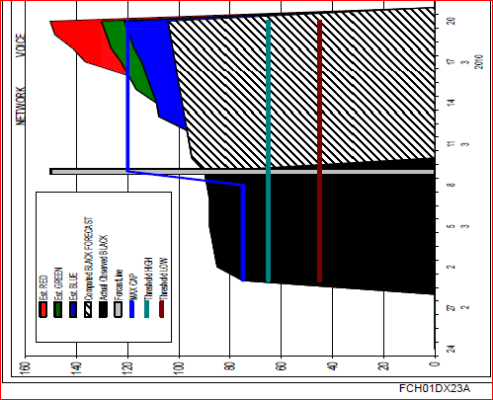
The Impossible
Chart
“MUST” Contain:
History
Organic Growth
Known projects – low potential
Known projects – high potential
Known projects – approved
Thresholds
Indication of costs
– Huge problem
Notes:
The Impossible Chart.
We were challenged with an impossible chart. By being able to do this in Excel showed that capacity could, in fact, be done and was the beginnings of our efforts. Notice that this is a 2010 chart. It took us three years to mature to the point that we moved to BMC Capacity Optimization which was August 2013.

Slide 10
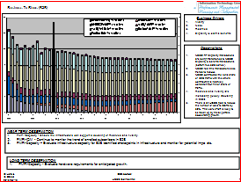
BMC Capacity Optimization
Feature Set
Historical Data
Forecast
Business Drivers
Observations
Near Term Observations
Long Term Observations
Data sources
Indication of costs
– Huge problem
Notes:
BMC Capacity Optimization. After three years we found the BMC Capacity Optimization tool (we started on 9.x). This was less of a sea change and more of a tool change as we were a few years into our mission.
Notice our chart has most of the original requirement except cost, which remains an ongoing battle.
Now some three years after having BMC TrueSight Capacity Optimization we routinely make charts and observations for applications.
In fact, we have some 350 applications we can report on. We could not do this without the Configuration Management Team making the associations with Atrium ADDM and discovery.

Slide 11
Quickly Mature
Data collection is now ‘automatic’
Charts are now ‘automatic’
Analysts can now analyze
Reports are routine
Insights are timely
Intelligence is actionable
Good Enough is Good Enough
Suck Less
We made our basic reporting ‘suck less’ and were liberated to do more detailed analysis, including detailed application analysis, and chargeback.
Notes:
Quickly Mature. BMC allowed us to quickly mature as we really did out grow our Excel tools and techniques, and had a pretty clear idea of what we wished to produce, what data we needed, where it was, and how to get it.
Very quickly, thanks to BMC Sales Support and Moviri our Most Excellent Contractor, we automated several data collections. Made routine charts ‘automatically’ and finally spent more time analyzing data than collecting data.
Now reports are routine, insights are timely, and intelligence is actionable.
We made our basic reporting ‘suck less’ and were liberated to do more detailed analysis, including detailed application analysis, and chargeback.
The key to this is to make the data good enough, and improve our process such that it sucks less.

Slide 12
Chargeback for Projects
We went from what amounted to equipment managers guessing to a mostly automated process that mostly updates automatically.
It is now ‘transparent’, auditable and relatively low effort.
We gave an Engage 2014 presentation on our chargeback journey. If you are thinking of chargeback, that presentation is as relevant now as it was then.
Good Enough is Good Enough
Suck Less
Notes:
Chargeback for Projects. This allowed us to do basic charge back and took over the labor intensive job of project cost accounting.
We went form equipment managers guessing, to an automated process that can detect configuration changes and update accordingly. We went from monthly guesses to calculating allocations by the hour.
The process is transparent, auditable, and relatively low effort, but it is still a bit of a pain, for a couple of people.
We gave a presentation at Engage2014 that reviewed our charge back journey in some detail. It is still relevant if you wish a copy.
The key to this is to make the data good enough, and improved our process such that it sucks less.

Slide 13
Retire Servers
For the VERY FIRST TIME in our 70+ year history we retired more servers than we built for a couple of months that year.
Server count staying neutral is a HUGE win.
The cost conversation let people understand the difference between the SERVER and the SERVICE. They moved low use services so they could retire the server.
Good Enough is Good Enough
Suck Less
Notes:
Retire Servers. Our efforts informed a lot of senior people of the cost of infrastructure. This knowledge and some leadership changes allowed the first concentrated effort to retire servers. We, for the very first time in our 70 year + history, retired more servers than we built for a couple months of that year.
While some of this was cleaning skeletons out of the closet, it does not happen without a cost conscious mindset AND some of the data assembled in BCO.
This was a huge win as I bet most of us in this room have NEVER retired more servers in a quarter than was built in the quarter.
The key to this is to make the data good enough, and improved our process such that it sucks less.

Slide 14
Application Chargeback
Until senior management is content with ‘good enough is good enough’ then you will be doing more of a ‘shame back’ than a true charge back.
Charge back is an elusive, fickle, goal. Not everyone will approve. Mostly for reasons that have nothing to do with charge back.
Good Enough is Good Enough
Suck Less
Chargeback has nothing to do with finance and everything to do with changing behavior.
Notes:
Application Charge Back and Beyond. Now we are doing application charge back or more of a shame back. Comparing the cost of different applications and application portfolios throughout the business. We show back several million dollars a month.
Charge back is an elusive, fickle goal. Not everyone will approve, mostly for reasons that have nothing to do with charge back.
It is good to realize that chargeback has nothing to do with finance and everything to do with changing behavior.
The key to this is to make the data good enough, and improving our process such that it sucks less.

Slide 15
Call To Action - Questions
You must START
    You ALREADY have the tools, data, questions
Answer questions as best you can with what you have –
  Good enough is good enough
Mature little bits everywhere –
  Make each part suck less
Good Enough is Good Enough
Suck Less
But first, you must START
Notes:
As a call to action I say, START. For the love of data, start.
You already have the tools. That is databases, query tools, Excel
You already have some of the data. Device metrics, costs, if only budget numbers, and counts of work.
You already know most of the questions. How much, on average is each piece of infrastructure? How much on average is each piece of work? What is my most used device? How much more work can I do on existing equipment?
Answer your questions as best you can with what you have. Note qualifiers, exceptions, unknowns, and limited data, but answer the question.
Mature little bits everywhere – Make each part suck less. What will it take to remove a qualifier, or exception? How can you get better data or better understanding?
At some point the process you are using will not be sufficient to gather, coordinate, store, retrieve, display, or manipulate your data, reports, intelligence and action items. When you get there, big changes are needed but you will have a reasonably clear idea of what will be needed. But first you must START.
We did this by making our data good enough, and improving our processes such that it sucks less.

Slide 16

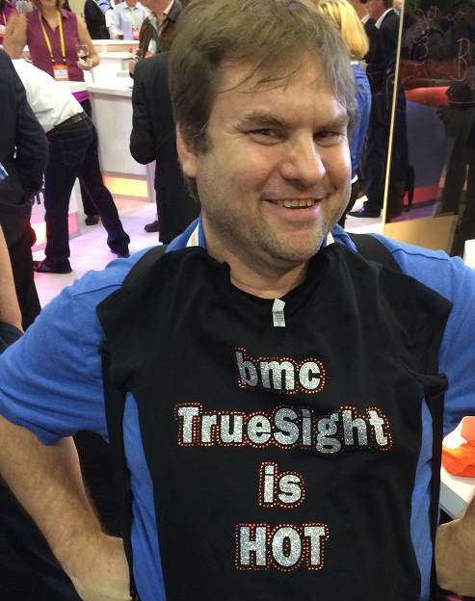



Submit your card with: “Suck Less” on the back and we will send you a link to the presentation and materials.
Thank You.
Ben Davies
Sr. IT Business Consultant
918.814.6588
ben_davies@hcsc.net
www.hcsc.com
Twitter @MrBenHoney
Submit a review at the registration desk. Say that Mr. Ben is awesome!
Mostly because I am, but also because I asked nicely. Please.
I have three sessions – so I am in competition with other versions of myself
Notes:
Thank you for your time and attention.
Feel free to talk to us, at the conference, or by phone or email.
Please submit a review at the registration desk. Say that Mr. Ben is awesome! Mostly because we are, but also because we asked nicely. Please.
I have three sessions this year – so I am in competition with the other versions of myself.
Submit your card with: “Suck Less” on the back and we will send you a link to the presentation.
https://twitter.com/MrBenHoney
@MrBenHoney

Slide 17
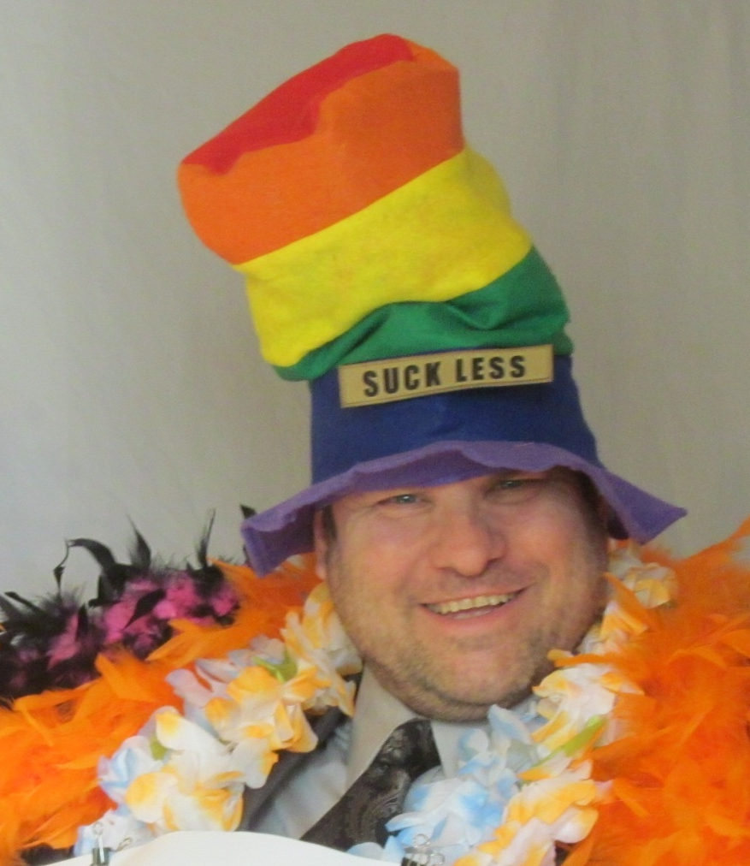
Call To Action:
Just START
Questions?
Notes:
Thank you for your time and attention.

Slide 18

© Copyright 2016 BMC Software, Inc.

Slide 19

© Copyright 2016 BMC Software, Inc.

Slide 20
Bonus
Material
Free to a good home

Slide 21
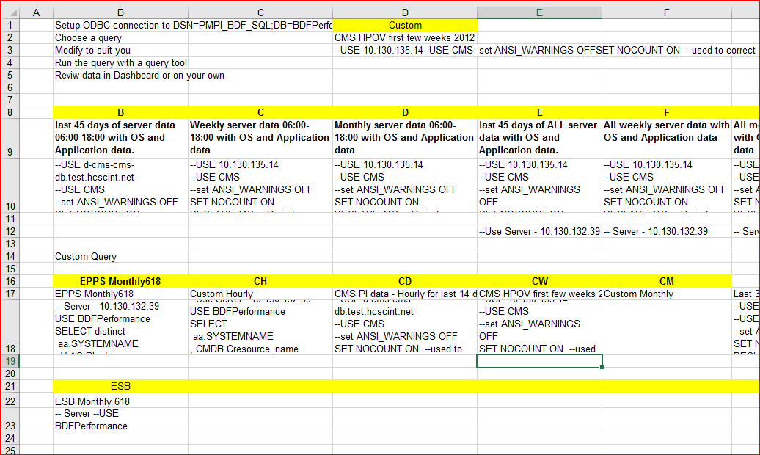
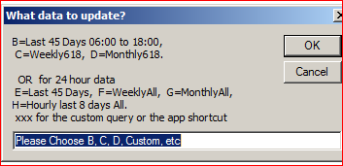
A VBA script calls these queries and populates the DATA tab.
THIS is how you start maturing your data RIGHT NOW.
If your data can not be queried with a query tool
IT IS NOT ready for a tool like BCO!

Slide 22
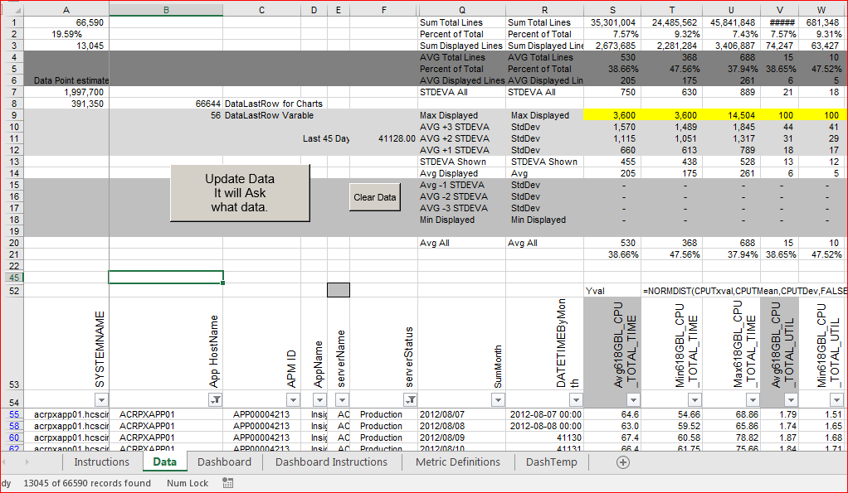
VBA Script to get Dynamic data, sum and subtotal with statics on the top.
Queries, data, dashboard.

Slide 23
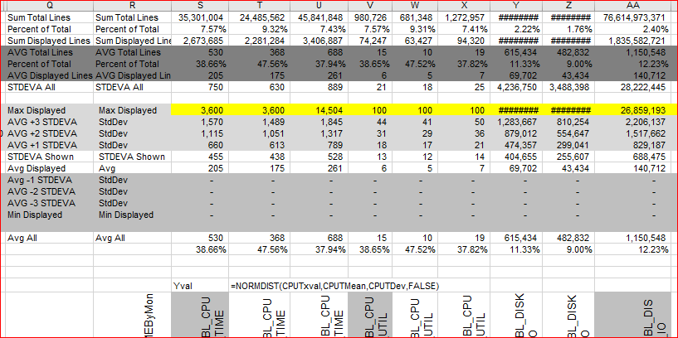
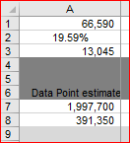

Slide 24
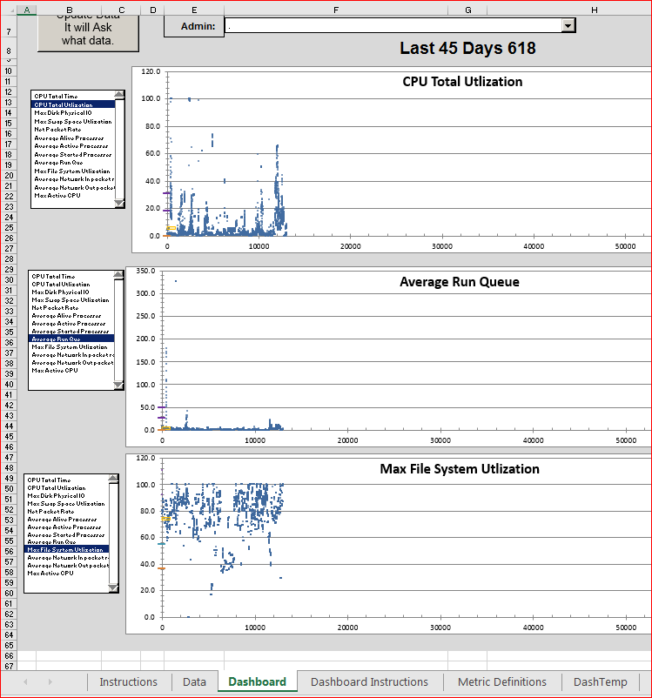
These charts updated based on the filter of the previous screen.
metrics chosen to the left so you could compare different metrics.
The horizontal axis is roughly time as the data is sorted by device and time in the query

Slide 25
Sub UpdateDataButton()
There are scripts in the notes sections that will help explain some of the VBA magic.
Notes:
The script behind the button..
======
Sub UpdateDataButton()
'This strings together many of the functions to update all data on the HP Data Analysis Template.
Application.ScreenUpdating = False
'Start from a known place
Sheets("Data").Select
Range("A6").Select
'Run through the updates and whatever else
Call ClearData
Call DeleteUnused
Call GetHPData
Call RefreshCounts
'Call RefreshCharts
Call RefreshDashChart01
Call RefreshDashChart02
Call RefreshDashChart03
Call RefreshDashTemp
' Call RefreshDashboardServerList
'Get back to where you started.
Sheets("Data").Select
Range("A6").Select
Application.ScreenUpdating = True
'Should be done!
End Sub
============

Slide 26
Sub GetHPData()
The most liberating part of this technique is that Excel can query a database ‘on its own’. Click a button, the VBA script asks which cell contains the query, and poof, Data in the data tab.
Notes:
The get data script..
===========
Sub GetHPData()
'This will query the Business Data Forecasting database with your query.
'This assumes that you have an ODBC connection already defined.
Dim BDFPQuery As String
Dim strName As String
Dim CustomName As String
Dim CustsomQueery As String
'Assign variables
strName = InputBox(prompt:="B=Last 45 Days 06:00 to 18:00, " _
& vbCrLf & " C=Weekly618, D=Monthly618. " _
& vbCrLf & vbCrLf & " OR for 24 hour data " _
& vbCrLf & " E=Last 45 Days, F=WeeklyAll, G=MonthlyAll, H=Hourly last 8 days All. " _
& vbCrLf & " xxx for the custom query or the app shortcut " _
& vbCrLf & " I=400 Days 816, J=400 Days All. ", _
Title:="What data to update?", Default:="Please Choose B, C, D, Custom, etc")
If strName = "Please Choose B, C, D etc" Or _
strName = vbNullString Then
'This did not go well. Exiting!
Exit Sub
ElseIf strName = "Custom" Then
'Menu System for custom queries. This keeps from having to update the VBA code.
'The admin is expected to answer "Custom" AND know which cells to put in D2 and D3.
CustomName = InputBox(prompt:="What cell for name?", Title:="What cell for Name", Default:="B17")
CustomQuery = InputBox(prompt:="What cell for Query?", Title:="What cell for Query", Default:="B18")
Worksheets("Instructions").Range("D2").Value = "= " & CustomName
Worksheets("Instructions").Range("D3").Value = "= " & CustomQuery
BDFPQuery = Worksheets("Instructions").Cells(3, "D").Value
Worksheets("Data").Range("D11").Value = Worksheets("Instructions").Cells(2, "D").Value
GoTo EndSelection
Else
Select Case strName
Case "XXX", "xxx"
BDFPQuery = Worksheets("Instructions").Cells(3, "D").Value
Worksheets("Data").Range("D11").Value = Worksheets("Instructions").Range("D2").Value
Case "B", "b"
BDFPQuery = Worksheets("Instructions").Cells(10, "B").Value
Worksheets("Data").Range("D11").Value = "Last 45 Days 618"
Case "C", "c"
BDFPQuery = Worksheets("Instructions").Cells(10, "C").Value
Worksheets("Data").Range("D11").Value = "Weekly618"
Case "D", "d"
BDFPQuery = Worksheets("Instructions").Cells(10, "D").Value
Worksheets("Data").Range("D11").Value = "Monthly618"
Case "E", "e"
BDFPQuery = Worksheets("Instructions").Cells(10, "E").Value
Worksheets("Data").Range("D11").Value = "Last 45 Days ALL"
Case "F", "f"
BDFPQuery = Worksheets("Instructions").Cells(10, "F").Value
Worksheets("Data").Range("D11").Value = "Weekly ALL"
Case "G", "g"
BDFPQuery = Worksheets("Instructions").Cells(10, "G").Value
Worksheets("Data").Range("D11").Value = "Monthly ALL"
Case "H", "h"
BDFPQuery = Worksheets("Instructions").Cells(10, "H").Value
Worksheets("Data").Range("D11").Value = "Hourly All"
Case "I", "i"
BDFPQuery = Worksheets("Instructions").Cells(10, "I").Value
Worksheets("Data").Range("D11").Value = "Last 400 Days 0618"
Case "J", "j"
BDFPQuery = Worksheets("Instructions").Cells(10, "J").Value
Worksheets("Data").Range("D11").Value = "Lasts 400 days All"
Case "EPPS", "epps"
BDFPQuery = Worksheets("Instructions").Cells(18, "B").Value
Worksheets("Data").Range("D11").Value = "EPPS App Data Monthly 618 "
Case "CH", "ch"
BDFPQuery = Worksheets("Instructions").Cells(18, "C").Value
Worksheets("Data").Range("D11").Value = "Custom Hourly "
Case "CD", "cd"
BDFPQuery = Worksheets("Instructions").Cells(18, "D").Value
Worksheets("Data").Range("D11").Value = "Custom Hourly "
Case "CW", "cw"
BDFPQuery = Worksheets("Instructions").Cells(18, "E").Value
Worksheets("Data").Range("D11").Value = "Custom Hourly "
Case "CM", "cm"
BDFPQuery = Worksheets("Instructions").Cells(18, "F").Value
Worksheets("Data").Range("D11").Value = "Custom Hourly "
Case Else
'assume Monthly 618
BDFPQuery = Worksheets("Instructions").Cells(10, "D").Value
Worksheets("Data").Range("D11").Value = "Monthly618"
End Select
EndSelection:
End If
'An opportunity not to do the update
' UpdateAnswer = InputBox(prompt:="Update Data? This could take some time", _
' Title:="Update Data?", Default:="N")
' If UpdateAnswer = "N" Or _
' UpdateAnswer = vbNullString Then
' GoTo Hell
' End If
'Go get the data
Call ClearData
Sheets("Data").Select
Range("A1").Select
With ActiveSheet.QueryTables.Add(Connection:=Array(Array( _
"ODBC;DSN=CMS_SQL;DB=CMS;UID=BDFapp;PWD=Pa$$W0rd;"), _
Array("e=2048;PageTimeout=5;")), Destination:=Range("A55"))
ssql = BDFPQuery
.CommandText = ssql
.Name = "Query from BDFPerformance Database"
.FieldNames = False
.RowNumbers = False
.FillAdjacentFormulas = False
.PreserveFormatting = True
.RefreshOnFileOpen = False
.BackgroundQuery = True
.RefreshStyle = xlOverwriteCells
.SavePassword = True
.SaveData = True
.AdjustColumnWidth = False
.RefreshPeriod = 0
.PreserveColumnInfo = True
.Refresh BackgroundQuery:=False
End With
Hell:
End Sub

Slide 27
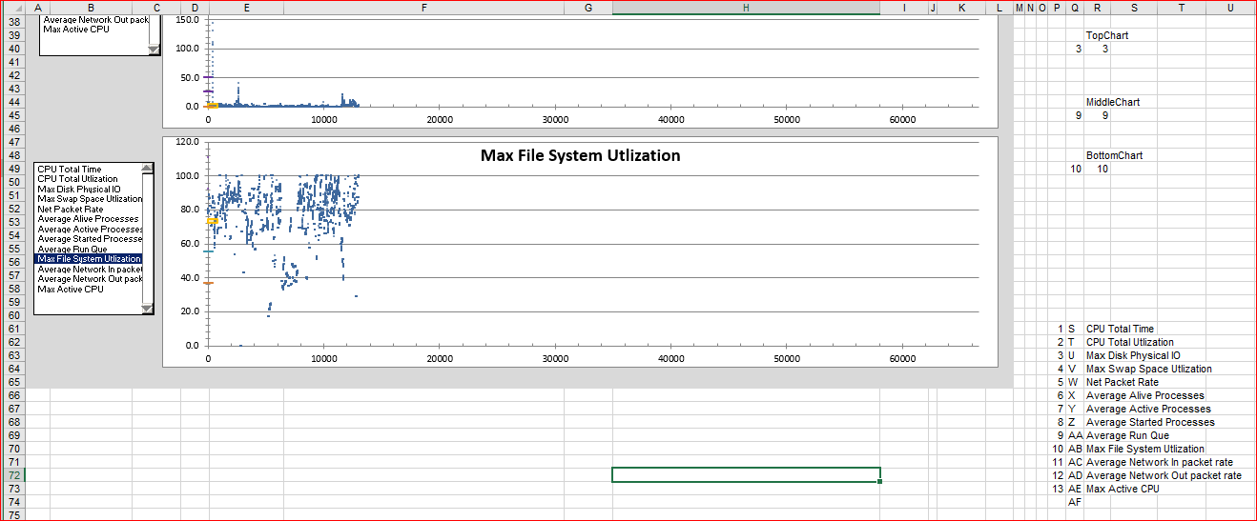
Sub RefreshDashChart01()
There is code in the comments that shows how we did the chats.
Notes:
Sub RefreshDashChart01()
'Sub Test()
Dim xCell As Range
Dim i As Integer
Dim m As Integer
Dim ColAlp As String
Dim DataLastRow As Double
DataLastRow = Range("Data!B8").Value
Dim ChartXAxis As Double
ChartXAxis = Range("Dashboard!S11").Value
'ActiveChart.Axes(xlCategory).MaximumScale = ChartXAxis
Sheets("Dashboard").Select
ActiveSheet.ChartObjects("Chart 1").Activate 'Change as approperate to match chart name
ActiveChart.Axes(xlCategory).MaximumScale = ChartXAxis
ActiveChart.Axes(xlCategory).MinimumScale = 0 'x axis
ActiveChart.Axes(xlCategory).TickLabels.Font.Size = 6
ActiveChart.Axes(xlValue).MinimumScale = 0 'Y axis
ActiveChart.Axes(xlValue).TickLabelPosition = xlTickLabelPositionLow
ActiveChart.Axes(xlValue).TickLabels.Font.Bold = False
ActiveChart.Axes(xlValue).TickLabels.Font.ColorIndex = 16
ActiveChart.Axes(xlValue).TickLabels.Font.Name = "Arial"
ActiveChart.Axes(xlValue).TickLabels.Font.Size = 10
'This counts on a Named range which is the number column on the Dashboard
For Each xCell In Range("Dashboard!LinkVal")
If xCell.Value = Range("R40") Then 'Change to match dashboard
i = xCell.Row
m = xCell.Column
End If
Next
'This section sets up the data on the primary access.
ColAlp = ActiveSheet.Cells(i, m + 1).Value
ActiveChart.ChartTitle.Caption = ActiveSheet.Cells(i, m + 2).Value
ActiveChart.SeriesCollection(1).Name = ActiveSheet.Cells(i, m + 2).Value
ActiveChart.SeriesCollection(1).XValues = "=Data!$P$55:$Q$" & DataLastRow
ActiveChart.SeriesCollection(1).Values = "=Data!$" + ColAlp + "$55:$" + ColAlp + "$" & DataLastRow
'This section sets up the Average, and two standard deviations that show on the left of the chart
ActiveChart.SeriesCollection(2).Name = "=Data!$Q$11"
ActiveChart.SeriesCollection(2).Values = "=Data!$" + ColAlp + "$11"
ActiveChart.SeriesCollection(3).Name = "=Data!$Q$12"
ActiveChart.SeriesCollection(3).Values = "=Data!$" + ColAlp + "$12"
ActiveChart.SeriesCollection(4).Name = "=Data!$Q$14"
ActiveChart.SeriesCollection(4).Values = "=Data!$" + ColAlp + "$14"
ActiveChart.SeriesCollection(5).Name = "=Data!$Q$15"
ActiveChart.SeriesCollection(5).Values = "=Data!$" + ColAlp + "$15"
ActiveChart.SeriesCollection(6).Name = "=Data!$Q$16"
ActiveChart.SeriesCollection(6).Values = "=Data!$" + ColAlp + "$16"
Range("A1").Select
End Sub

